Slide 1
Software Quality Assurance and Testing Technology
1st Semester, Fall 2022
Xiaoping CHE (xpche@bjtu.edu.cn)
Associate Professor
School of Software Engineering
Beijing Jiaotong University

Slide 2
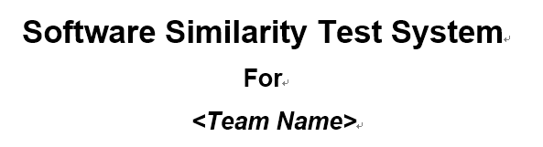
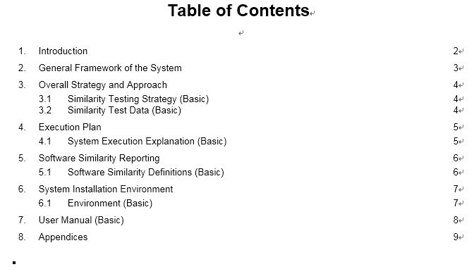

Slide 3
Rules
Project 20%
Assignments 40%
Final Exam 40%

Slide 4
How
16 Weeks Plan
Week 1: The basic concepts and theories of testing
Week 2-3: Principles of Testing
Week 4-5: White Box Testing
Week 6-7: Test Cases & Black Box Testing
Week 8: Usability Testing
Week 9: Mutation Testing & Finite Automata
Week 10: Mid-term Review and System Testing
Week 11: Empirical Software Testing
Week 12: Interaction System Testing
Week 13-14: ML & AI System Testing
Week 15-16: Conclusion & General Review

Slide 5





How
References
Ron Patton, Software Testing (2th Edition)
Glenford J. Myers, The Art of Software Testing (3rd Edition)
Gerald M. Weinberg, Perfect Software

Slide 6
16 Weeks Plan
Week 1: The basic concepts and theories of testing
Week 2-3: Principles of Testing
Week 4-5: White Box Testing
Week 6-7: Test Cases & Black Box Testing
Week 8: Usability Testing
Week 9: Mutation Testing & Finite Automata
Week 10: Mid-term Review and System Testing
Week 11: Empirical Software Testing
Week 12: Interaction System Testing
Week 13-14: ML & AI System Testing
Week 15-16: Conclusion & General Review

Slide 7
What is Testing
Software testing is a process, or a series of processes, designed to make sure computer code does what it was designed to do and, conversely, that it does not do anything unintended.
System
Input
Output

Slide 8
Test Cycle
Test
cases
Execution of cases
Additional tests
Results
Suspected causes
Regression tests
Evaluation
Corrections
Identified causes
Debugging

Slide 9
What is Testing
Level of detail
system
integration
module
unit
security
Accessibility
robustness
white box
black box
performance
usability
reliability
functional behaviour
Characteristics

Slide 10

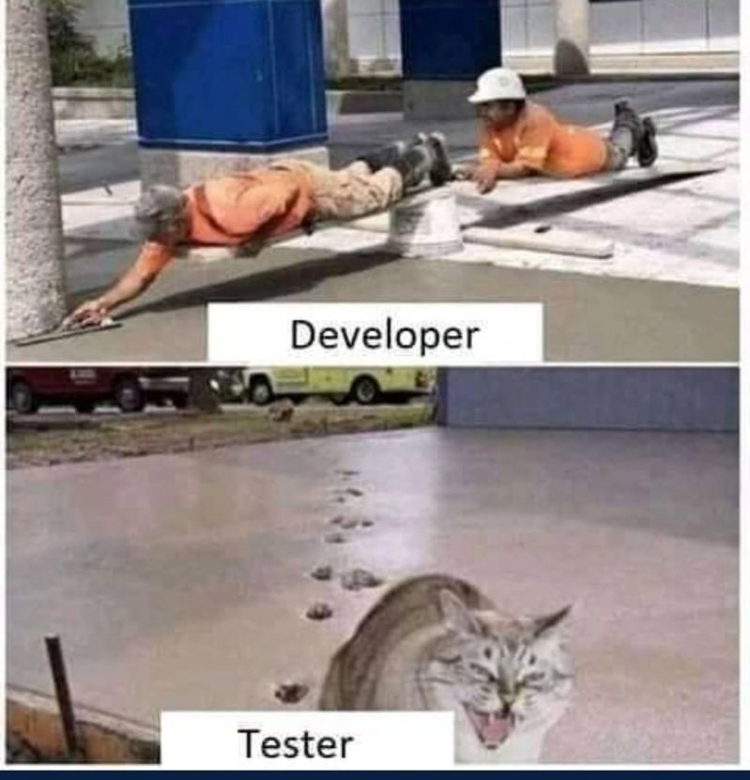
Developer and Tester
People are really hard to admit that they are wrong !

Slide 11
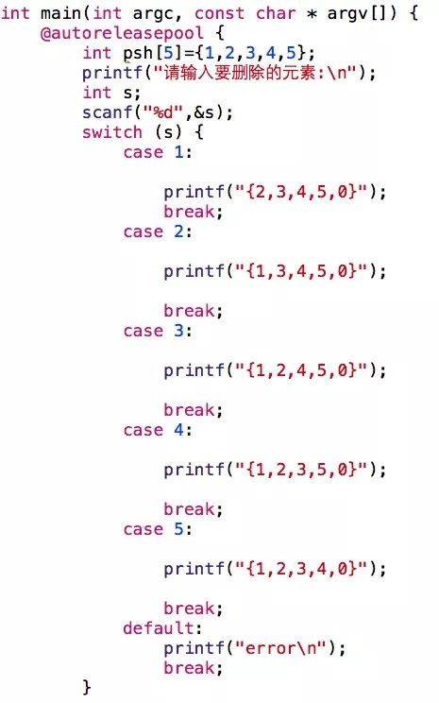
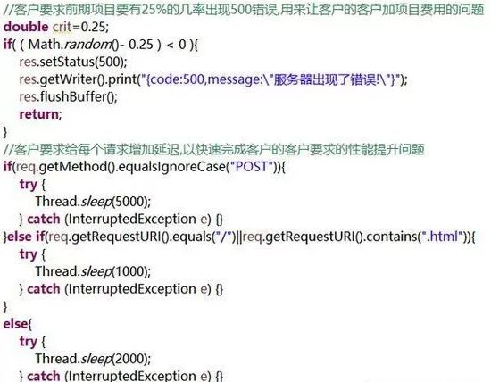
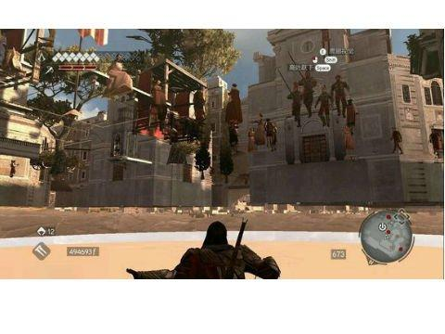
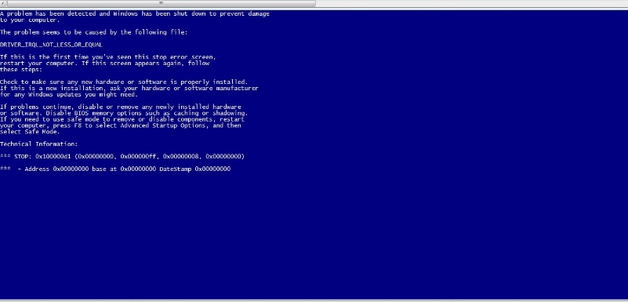
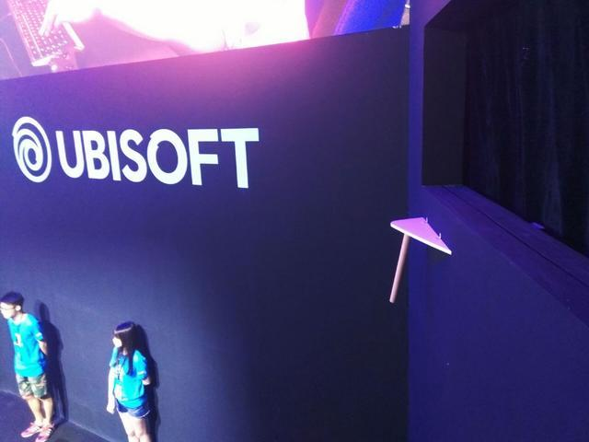
Why

Slide 12
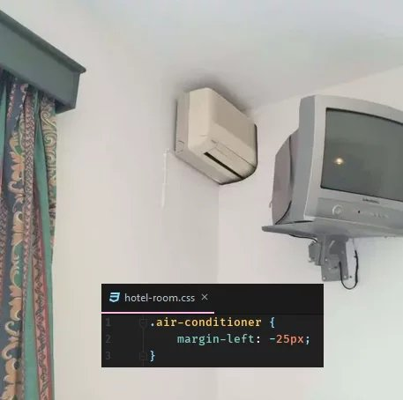
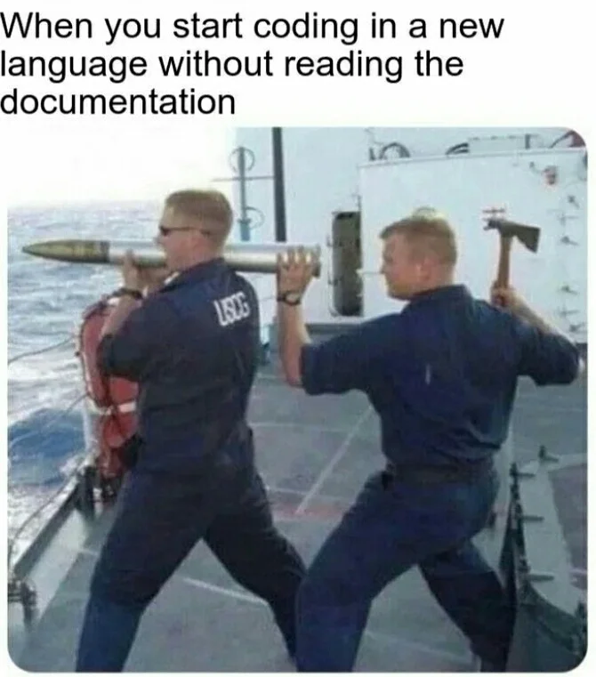
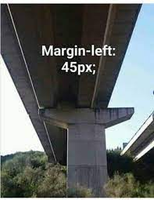
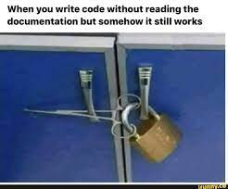
Why

Slide 13
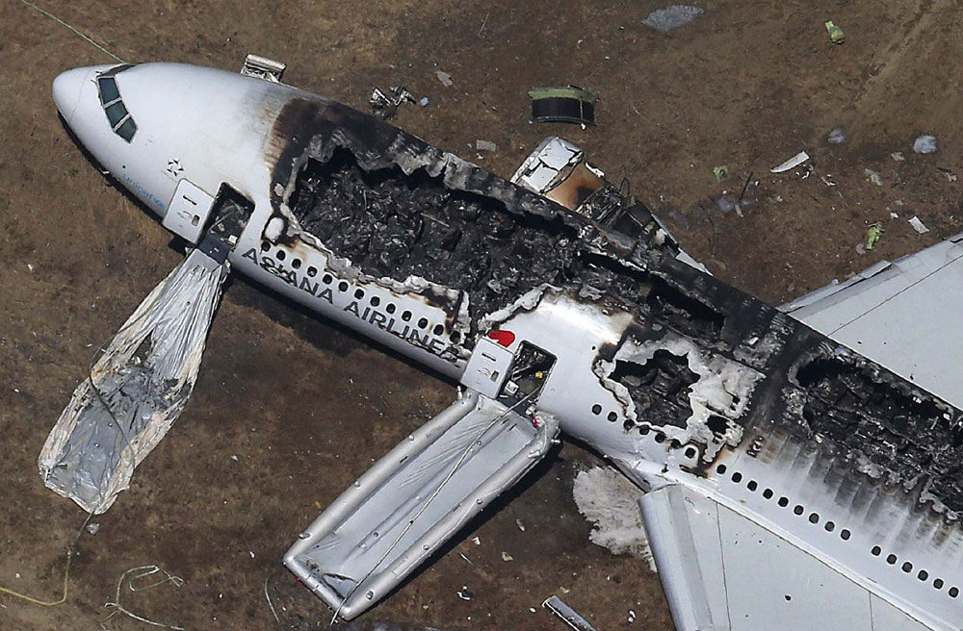
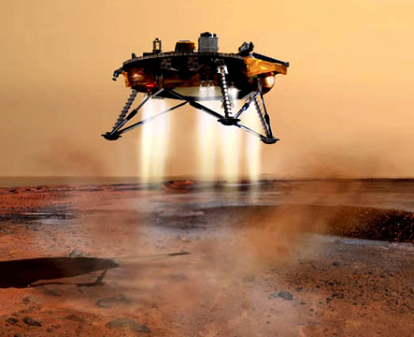


Why

Slide 14

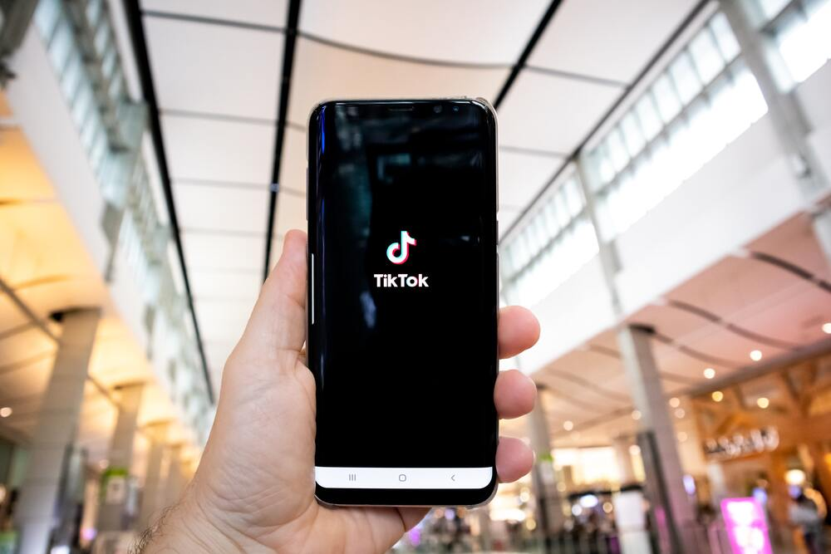
Why
On March 18, 2021, a bad actor illegally accessed and acquired personal data from T-Mobile customers. T-Mobile learned about the massive data breach on August 17, 2021. As was confirmed by T-Mobile, an unauthorized individual found their way past the mobile carrier’s security system and was able to access and steal the data of more than 50 million customers.
On May 3, when TikTok users logged on to the app the last thing they expected to see was all of their users gone. But this is exactly what happened. TikTok experienced a glitch that displayed the wrong followers/following count. Some users even had trouble accessing the app, with the app blocking their accounts.

Slide 15

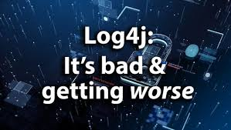
Why
In November, Tesla recalled close to 12,000 vehicles after discovering a glitch in its Full-Self Driving beta software. Following its most recent update on October 23, Tesla began receiving reports from customers reporting that their vehicles had falsely identified forward collision threats which had caused the automatic emergency braking (AEB) system to activate and bring the vehicle to a sudden stop.
The Log4j software bug has set the internet on fire after it has left millions of web servers vulnerable to hackers. The vulnerability was first discovered in the beginning of December. What makes this bug so terrifying is the fact that Log4j, an open-source logging library, is used by many companies worldwide, including high profile organizations like Apple, Amazon, Cisco, IBM, Microsoft, and many many more.

Slide 16
What
Let’s see how well you are
We want to design a program
The program reads three integers from an input box
The three integers represent three edges of a triangle
The program will tell you the triangle is scalene, isosceles or equilateral
3
3
3
Equilateral

Slide 17
What
Do you have a test case that represents a valid scalene triangle? (Note that test cases such as 1, 2, 3 and 2, 5, 10 do not warrant a yes answer because a triangle having these dimensions is not valid.)
Do you have a test case that represents a valid equilateral triangle?
Do you have a test case that represents a valid isosceles triangle? (Note that a test case representing 2, 2, 4 would not count because it is not a valid triangle.)
Do you have at least three test cases that represent valid isosceles triangles such that you have tried all three permutations of two equal sides (such as, 3, 3, 4; 3, 4, 3; and 4, 3, 3)?
Do you have a test case in which one side has a zero value?
Do you have a test case in which one side has a negative value?
Do you have a test case with three integers greater than zero such that the sum of two of the numbers is equal to the third? (That is, if the program said that 1, 2, 3 represents a scalene triangle, it would contain a bug.)

Slide 18
What
Do you have at least three test cases in category 7 such that you have tried all three permutations where the length of one side is equal to the sum of the lengths of the other two sides (e.g., 1, 2, 3; 1, 3, 2; and 3, 1, 2)?
Do you have a test case with three integers greater than zero such that the sum of two of the numbers is less than the third (such as 1, 2, 4 or 12, 15, 30)?
Do you have at least three test cases in category 9 such that you have tried all three permutations (e.g., 1, 2, 4; 1, 4, 2; and 4, 1, 2)?
Do you have a test case in which all sides are zero (0, 0, 0)?
Do you have at least one test case specifying non-integer values (such as 2.5, 3.5, 5.5)?
Do you have at least one test case specifying the wrong number of values (two rather than three integers, for example)?
How many “Yes” you got?
Average 7.8 for the professional programmers

Slide 19
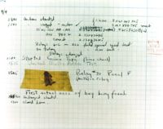
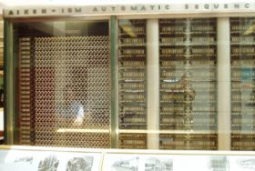
Introduction
What is a computer bug?
In 1947 Harvard University was operating a room-sized computer called the Mark II.
A moth flew into the computer and was zapped by the high voltage when it landed on a relay.
Hence, the first computer bug!

Slide 20
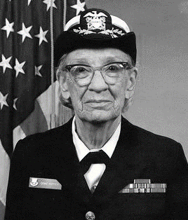
Introduction
Grace Hopper
Grace Brewster Murray Hopper was an American computer scientist and United States Navy rear admiral.
One of the first programmers of the Harvard Mark I computer, she was a pioneer of computer programming who invented one of the first linkers.
1906-1992

Slide 21

Introduction
Grace Hopper

Slide 22
Introduction
Bugs a.k.a. …
Defect
Fault
Problem
Error
Incident
Anomaly
Variance
Failure
Inconsistency
Product Anomaly
Product Incidence
Feature

Slide 23
Introduction
Fault, Error & Failure
Software Fault : A static defect in the software (i.e., defect)
Software Error : An incorrect internal state that is the manifestation of some fault
Software Failure : External, incorrect behavior with respect to the requirements or other description of the expected behavior

Slide 24
Introduction
Software Fault : A static defect in the software (i.e., defect, bug)
public static void CSta (int [ ] numbers)
{
int length = numbers.length;
double mean, sum;
sum = 0.0;
for (int i = 1; i < length; i++)//i=0
{
sum += numbers [ i ];
}
mean = sum / (double) length;
System.out.println ("mean: " + mean);
}
Fault

Slide 25
Introduction
Software Error : An incorrect internal state that is the manifestation of some fault
public static void CSta (int [ ] numbers)
{
int length = numbers.length;
double mean, sum;
sum = 0.0;
for (int i = 1; i < length; i++)//i=0
{
sum += numbers [ i ];
}
mean = sum / (double) length;
System.out.println ("mean: " + mean);
}
Test Input: [3,4,5]
Error
sum=3+4+5
sum=4+5

Slide 26
Introduction
Software Failure : External, incorrect behavior with respect to the requirements or other description of the expected behavior
public static void CSta (int [ ] numbers)
{
int length = numbers.length;
double mean, sum;
sum = 0.0;
for (int i = 1; i < length; i++)//i=0
{
sum += numbers [ i ];
}
mean = sum / (double) length;
System.out.println ("mean: " + mean);
}
Test Input: [3,4,5]
sum=3+4+5
sum=4+5
failure
mean=4
mean=3

Slide 27
Introduction
PIE Model
Execution/Reachability : The location or locations in the program that contain the fault must be reached
Infection : The state of the program must be incorrect
Propagation : The infected state must propagate to cause some output of the program to be incorrect

Slide 28
Introduction
A test executing the fault may not produce an error!
public static void CSta (int [ ] numbers)
{
int length = numbers.length;
double mean, sum;
sum = 0.0;
for (int i = 1; i < length; i++)//i=0
{
sum += numbers [ i ];
}
mean = sum / (double) length;
System.out.println ("mean: " + mean);
}
Test Input: [0,4,5]
sum=0+4+5
sum=4+5
Not an error for “sum”
mean=3
mean=3

Slide 29
Introduction
An error may not be propagated to the output!
public static void CSta (int [ ] numbers)
{
int length = numbers.length-1;
double mean, sum;
sum = 0.0;
for (int i = 0; i < length; i++)
{
sum += numbers [ i ];
}
mean = sum / (double) length;
System.out.println ("mean: " + mean);
}
Test Input: [3,5,4]
Error
sum=3+5+4
sum=3+5
mean=12/3=4
mean=8/2=4
No Failure
29

Slide 30
Introduction
Defective Software
We develop programs that contain defects
How many? What kind?
Hard to predict the future, however…it is highly likely, that the software we (including you!) will develop in the future will not be significantly better. ☹

Slide 31
Introduction
Sources of Problems
Requirements Definition: Erroneous, incomplete, inconsistent requirements.
Design: Fundamental design flaws in the software.
Implementation: Mistakes in chip fabrication, wiring, programming faults, malicious code.
Support Systems: Poor programming languages, faulty compilers and debuggers, misleading development tools.

Slide 32
Introduction
Sources of Problems (Cont’d)
Inadequate Testing of Software: Incomplete testing, poor verification, mistakes in debugging.
Evolution: Sloppy redevelopment or maintenance, introduction of new flaws in attempts to fix old flaws, incremental escalation to inordinate complexity.

Slide 33
Introduction
Adverse Effects of Faulty Software
Communications: Loss or corruption of communication media, non delivery of data.
Space Applications: Lost lives, launch delays.
Defense and Warfare: Misidentification of friend or foe.

Slide 34
Introduction
Adverse Effects of Faulty Software (Cont’d)
Transportation: Deaths, delays, sudden acceleration, inability to brake.
Safety-critical Applications: Death, injuries.
Electric Power: Death, injuries, power outages, long-term health hazards (radiation).

Slide 35
Introduction
Adverse Effects of Faulty Software (Cont’d)
Money Management: Fraud, violation of privacy, shutdown of stock exchanges and banks, negative interest rates.
Control of Elections: Wrong results (intentional or non-intentional).
Control of Jails: Technology-aided escape attempts and successes, accidental release of inmates, failures in software controlled locks.
Law Enforcement: False arrests and imprisonments.

Slide 36
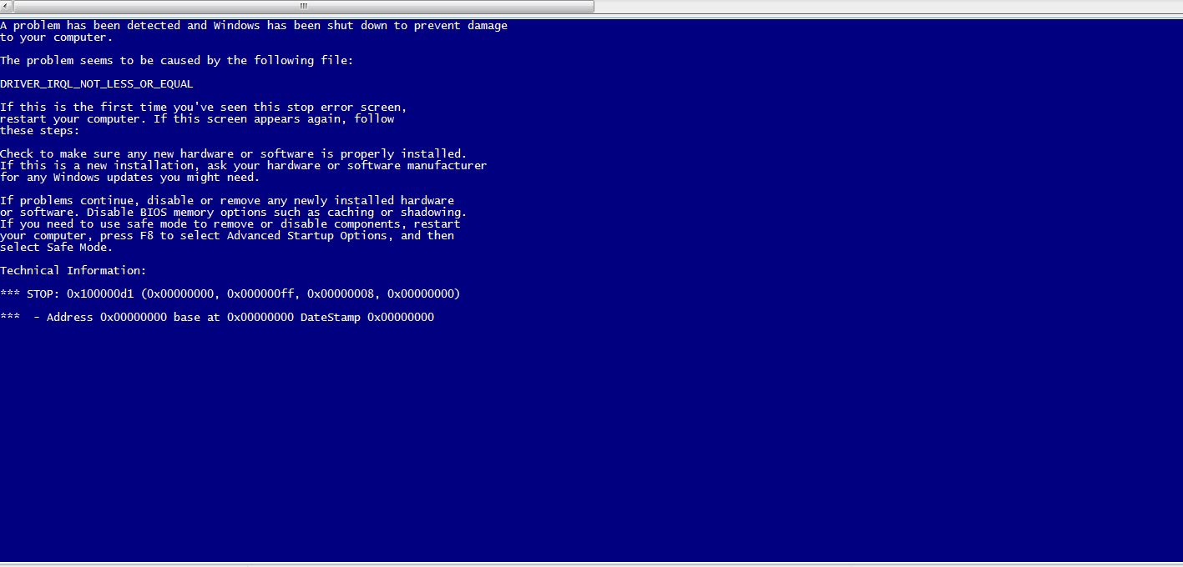
Introduction
Bug

Slide 37
Introduction
Bug in Space Code
Project Mercury’s FORTRAN code had the following fault:
DO I=1.10 instead of ... DO I=1,10
The fault was discovered in an analysis of why the software did not seem to generate results that were sufficiently accurate.
The erroneous 1.10 would cause the loop to be executed exactly once!

Slide 38

Introduction
Bitcoin
Launched in 2010, Japanese bitcoin exchange, Mt. Gox, was the largest in the world.
After being hacked in June, 2011, Mt. Gox stated that they’d lost over 850,000 bitcoins (worth around half a billion US dollars at the time of writing).

Slide 39
Introduction
Bitcoin
Although around 200,000 of the bitcoins were recovered, Mark Karpeles admits “We had weaknesses in our system, and our bitcoins vanished.”

Slide 40
Introduction
Discussion …
Have you heard of other software bugs?
In the media?
From personal experience?
Does this embarrass you as a future software engineer?

Slide 41
Introduction
System Functional requirements
Other software requirements
Customer requirements Specification
Unit Test
Design Specification
User Environment
Unit Test
Components
Integration Test
Function Test
System Test
Acceptance Test
Installation Test
Integrated modules
Functioning system
Verified, validated software
Accepted test
System in use
Unit Test

Slide 42
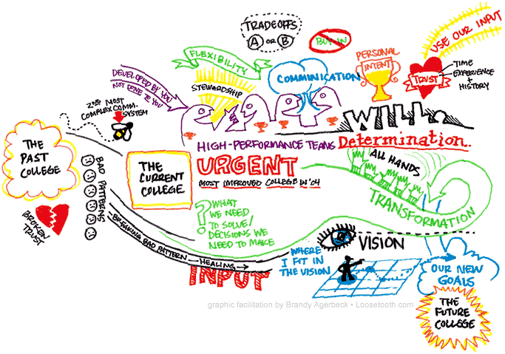
Introduction
Specification “if you can’t say it, you can’t do it”
not written.
not thorough enough.
constantly changing.
not communicated to the entire team in a timely manner.

Slide 43
Introduction
Specification “if you can’t say it, you can’t do it”
You have to know what your product is before you can say if it has a bug.
A specification defines the product being created and includes:
Functional requirements that describes the features the product will support. E.g., on a word processor
Save, print, check spelling, change font, …
Non-functional requirements are constraints on the product. E.g,
Security, reliability, user friendliness, platform, …

Slide 44
Introduction
A software bug occurs when at least one of these rules is true
The software does not do something that the specification says it should do.
The software does something that the specification says it should not do.
The software does something that the specification does not mention.
The software does not do something that the product specification does not mention but should.
The software is difficult to understand, hard to use, slow …

Slide 45
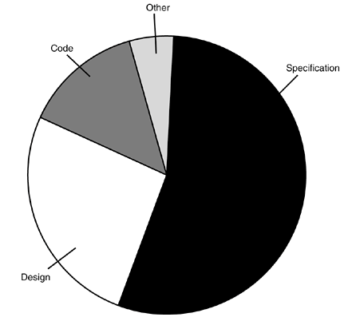
Introduction
Most bugs are not because of mistakes in the code …
Specification (~= 55%)
Design (~= 25%)
Code (~= 15%)
Other (~= 5%)

Slide 46
Introduction
Relative cost of bugs “bugs found later cost more to fix”
Cost to fix a bug increases exponentially (10^{x})
i.e., it increases tenfold as time increases
E.g., a bug found during specification costs $1 to fix.
… if found in design cost is $10
… if found in code cost is $100
… if found in released software cost is $1000

Slide 47
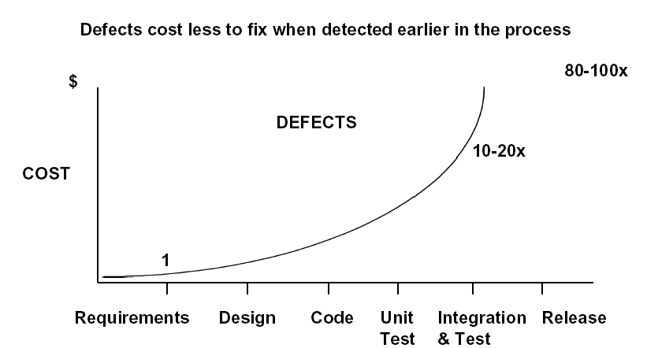
Introduction

Slide 48
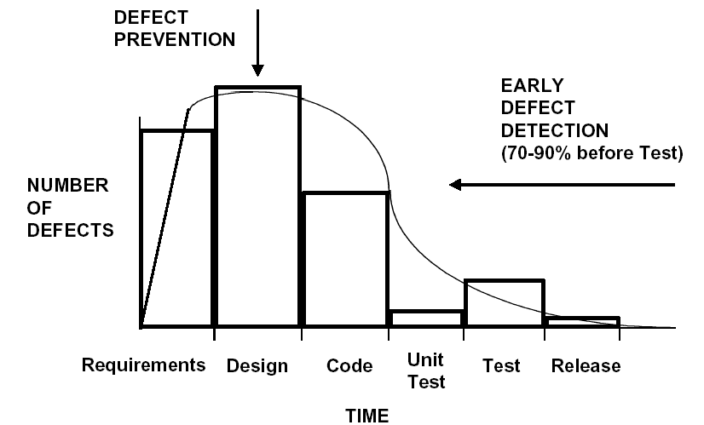
Introduction

Slide 49
The Cost of bugs
Introduction

Slide 50
Introduction
Bug Free Software
Software is in the news for the wrong reason
Security breach, Mars Lander lost, hackers getting credit card information, etc.
Why can’t software engineers develop software that just works?
As software gets more features and supports more platforms it becomes increasingly difficult to make it create bug-free.

Slide 51
Introduction
Discussion …
Do you think bug free software is unattainable?
Are their technical barriers that make this impossible?
Is it just a question of time before we can do this?
Are we missing technology or processes?

Slide 52
Introduction
Goal of a software tester
… to find bugs
… as early in the software development processes as possible
… and make sure they get fixed.
Advice: Be careful not to get caught in the dangerous spiral of unattainable perfection.

Slide 53
DEBUGGING vs. TESTING
TESTER DEBUGGER
Developer Developer
Test team Analyst
QA team
End user
THERE IS A FUNDAMENTAL CONFLICT BETWEEN THESE ROLES

Slide 54
TESTING
The operation of a system or application under controlled conditions and the evaluation of results with the intent of finding errors.
Should include normal and abnormal conditions
Testing intentionally attempts to make things go wrong to determine:
if things happen when they shouldn’t
if things don’t happen when they should
Oriented towards “detection”

Slide 55
DEBUGGING
DEBUGGING starts with an identified error and is the process of locating what is causing the bug and correcting the flaw.
It is NOT the process of showing that a bug exists.
Oriented towards “correction”.

Slide 56
Introduction
What to look for when interviewing someone for the position of software tester
Are they explorers?
Are they troubleshooters?
Are they relentless?
Are they creative?
Are they perfectionists (within reason)?
Do they exercise good judgment?
Are they tactful and diplomatic?
Are they persuasive?

Slide 57
Introduction
You now know …
… what is a bug
… the relationship between specification and bugs
… the cost of a bug relative to when it is found
… the unattainable goal of perfect software
… the goal of the software tester
… valuable attributes of a software tester

Slide 58
16 Weeks Plan
Week 1: The basic concepts and theories of testing
Week 2-3: Principles of Testing
Week 4-5: White Box Testing
Week 6-7: Test Cases & Black Box Testing
Week 8: Usability Testing
Week 9: Mutation Testing & Finite Automata
Week 10: Mid-term Review and System Testing
Week 11: Empirical Software Testing
Week 12: Interaction System Testing
Week 13-14: ML & AI System Testing
Week 15-16: Conclusion & General Review

Slide 59

Principle of Testing
Software is …
Requirements specification documents
Design documents
Source code
Test suites and test plans
Interfaces to hardware and software operating environment
Internal and external documentation
Executable programs and their persistent data

Slide 60
Principle of Testing
Software is …
ISO Standards of Software
The ISO/IEC 25000 series of standards
ISO/IEC 25000 - Guide to SQuaRE: Provides the SQuaRE architecture model, terminology, documents overview, intended users and associated parts of the series as well as reference models.
ISO/IEC 25001 - Planning and Management: Provides requirements and guidance for a supporting function which is responsible for the management of software product requirements specification and evaluation.
ISO/IEC 25010 - System and software quality models: Describes the model, consisting of characteristics and subcharacteristics, for software product quality, and software quality in use.
ISO/IEC 25012 - Data Quality model: defines a general data quality model for data retained in a structured format within a computer system. It focuses on the quality of the data as part of a computer system and defines quality characteristics for target data used by humans and systems.

Slide 61
Principle of Testing
Software is …
ISO Standards of Software
ISO/IEC 25020 - Measurement reference model and guide: Presents introductory explanation and a reference model that is common to quality measure elements, measures of software product quality and quality in use. Also provides guidance to users for selecting or developing, and applying measures.
ISO/IEC 25021 - Quality measure elements: Defines a set of recommended base and derived measures, which are intended to be used during the whole software development life cycle. The document describes a set of measures that can be used as an input for the software product quality or software quality in use measurement.
ISO/IEC 25022 - Measurement of quality in use: Describes a set of measures and provides guidance for measuring quality in use.

Slide 62
Principle of Testing
Software is …
ISO Standards of Software
ISO/IEC 25023 - Measurement of system and software product quality: Describes a set of measures and provides guidance for measuring system and software product quality.
ISO/IEC 25024 - Measurement of data quality: Defines quality measures for quantitatively measuring data quality in terms of characteristics defined in ISO/IEC 25012.
ISO/IEC 25030 - Quality requirements: Provides requirements and guidance for the process used to develop quality requirements, as well as requirements and recommendations for quality requirements.
ISO/IEC 25040 - Evaluation reference model and guide: Contains general requirements for specification and evaluation of software quality. Provides a framework for evaluating quality of software product and states the requirements for methods of software product measurement and evaluation.

Slide 63
Principle of Testing
Software is …
ISO Standards of Software
ISO/IEC 25041 - Evaluation guide for developers, acquirers and independent evaluators: Provides requirements, recommendations and guidelines for developers, acquirers and independent evaluators of the system and software product.
ISO/IEC 25042 - Evaluation modules: Defines the structure and content of the documentation to be used to describe an evaluation module. These evaluation modules contain the specification of the quality model (i.e. characteristics, subcharacteristics and corresponding product or quality in use measures), the associated data and information about its application.
ISO/IEC 25045 - Evaluation module for recoverability: Provides the specification to evaluate the subcharacteristic of recoverability defined under the characteristic of reliability of the quality model.

Slide 64
Principle of Testing
Software is …
ISO Standards of Software
But how about User Experience
ISO 9241-210:2010(en) Ergonomics of human-system interaction — Part 210: Human-centred design for interactive systems

Slide 65
Principle of Testing
The fact is …
We care about User’s functional behavior
We don’t care about User’s feeling

Slide 66
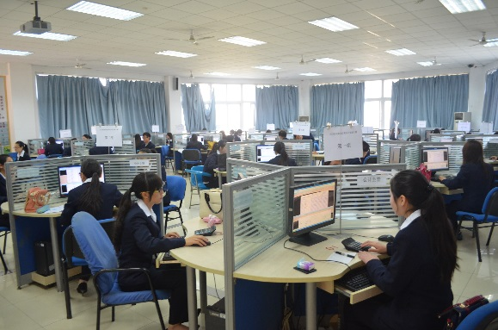
Principle of Testing
Software effort
Specification
Product reviews
Design
Scheduling
Feedback
Competitive information
acquisition
Test planning
Customer surveying
Usability data gathering
Look and feel specification
Software architecture
Programming
…

Slide 67
Product Components
Customer Requirements (Surveys, competitive info, Feedback)
MRD (Task/Feature description, Usability Data)
Specifications
Schedule
Design Docs (Architecture, Feature implementation, Interface agreement)
Test Documents (Plans, test cases, QA Milestone reports)
Online help
Release Notes / Read Me
Release packages

Slide 68
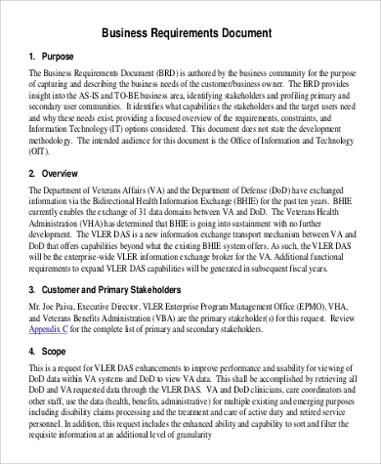
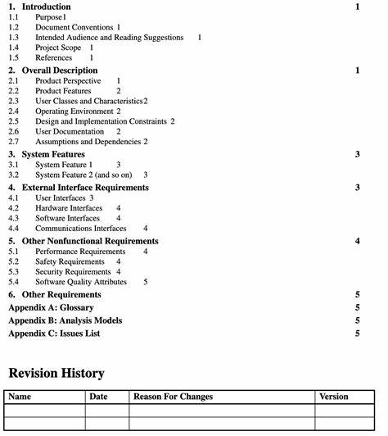
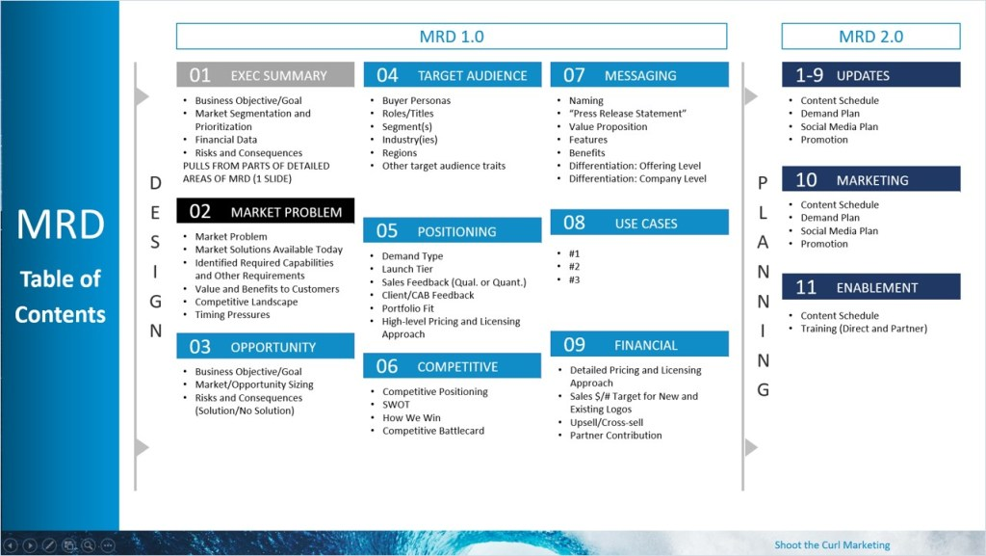
Product Components

Slide 69
Product Components
Customer Requirements (Surveys, competitive info, Feedback)
MRD (Task/Feature description, Usability Data)
Specifications
Schedule
Design Docs (Architecture, Feature implementation, Interface agreement)
Test Documents (Plans, test cases, QA Milestone reports)
Online help
Release Notes / Read Me
Release packages

Slide 70
Principle of Testing
Customer requirements
The software development team must determine what the customer wants.
How can you do this?
Guess?
Collect detailed information from surveys?
Get feedback from a previous version of the software?
Read reviews in magazines?
Get information about the competition?
Other ways?
The collected data is used to guide the specification effort.

Slide 71
Writing MRD AND SPEC
Principle of Testing
a project management issue - but a difficult one
For our purposes, verifiability is critical:
(bad) The system should be easy to use and user errors should be minimal.
(better) Experienced controllers should be able to use all the system functions after a total of two-hours of training.
After training, the average number of errors made by the experienced controllers will not exceed two per day.
But there are still problems. What are they?

Slide 72
Principle of Testing
Specification “If you don't know where you're going any road will take you there”
The specification takes the data from the customer requirements and other sources and defines:
The features of the software (functional requirements).
The constraints on these features (non-functional requirements).
Specifications can be:
formal (e.g., aerospace industry), rigid
informal (e.g., a .com start up), on a cocktail napkin or a whiteboard.

Slide 73
SOME WAYS TO QUANTIFY
Principle of Testing
Speed:
Processed transactions/second; user-response time; screen refresh time.
Size:
Number of bytes; number of records; number of transactions.
Ease of use:
Training time; number of help frames; define classes of users objectively

Slide 74
Principle of Testing
SOME WAYS TO QUANTIFY
Reliability:
Mean time to failure; probability of unavailability; rate of failure occurrence; availability.
Robustness:
Time to restart after failure; percentage of events causing failure; probability of data corruption on failure.
Portability:
Percentage of target-dependent statements; number of target systems.

Slide 75
Principle of Testing
Schedules
The goals of scheduling are to know:
What work needs to be completed?
How much work is left to do?
When will the work be finished?
Who will finish each task?
Other measurable queries.
A Gantt chart is a popular type of bar chart that illustrates a project schedule.

Slide 76
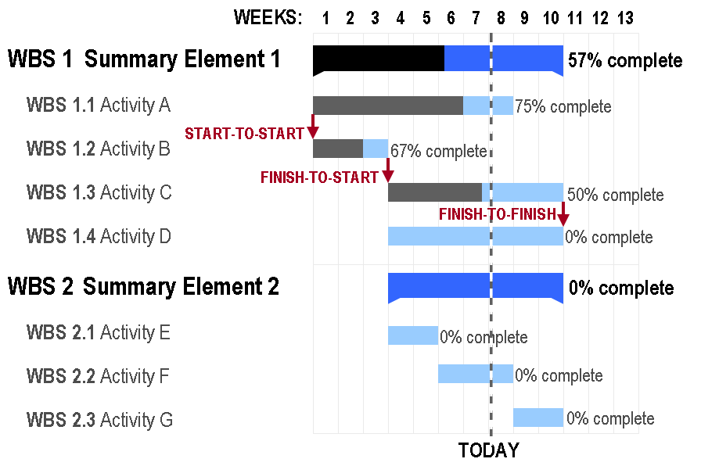
Principle of Testing
Gantt Chart

Slide 77
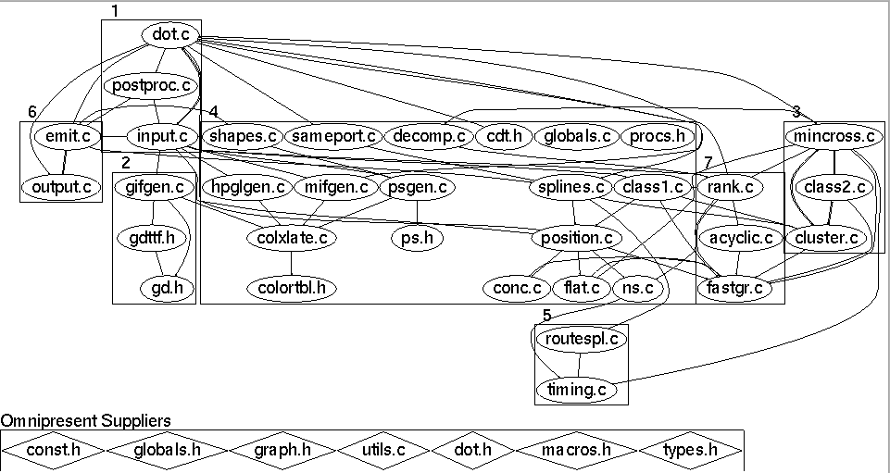
Principle of Testing
Design
Before coding begins on non-trivial software projects, a set of design documents are created to serve as blueprints.
Software Architecture
Data flow diagram
State transition diagram
Flowchart
Commented code

Slide 78
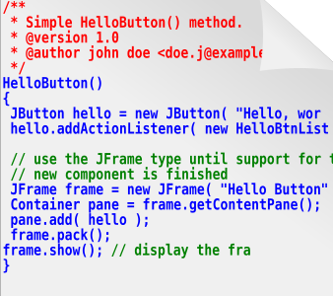
Principle of Testing
Source code … of course
The ultimate specification of the software!
‘Code is king’ philosophy is still prevalent.
Many programming languages and tools to choose from.

Slide 79
Principle of Testing
Test documents
Test plan
Quality objectives, resource needs, schedules, assignments, methods, etc.
Test cases
Inputs and expected outputs.
Bug reports
E.g., the Bugzilla web-based bug tracker.
Test tools and automation
Metrics, statistics, and summaries
Number of unresolved bugs, mean time to repair a bug, etc.

Slide 80
Principle of Testing
Software Project Staff
Project managers
Write product specification, manage the schedule, critical decision tradeoffs
Software architects, system engineers
Design the software, work closely with programmers
Programmers, developers, coders
Write code, fix bugs
Testers, quality assurance staff
Find bugs, document bugs, track progress of open bugs
Technical writers
Write manuals, on line documentation
Configuration managers, builders
Packaging and code, documents, and specifications

Slide 81
SD Team
图DEV-oriented model
DEV manager
Tester
Programmer
DOC
Management
PM
PM
Test Lead
DEV lead
DOC
Test Manager
DEV Manager
图PM-Oriented model
Tri-Model

Slide 82
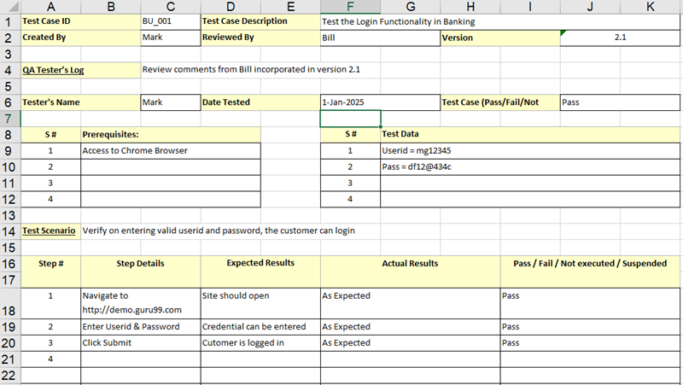
Example (Test case)

Slide 83
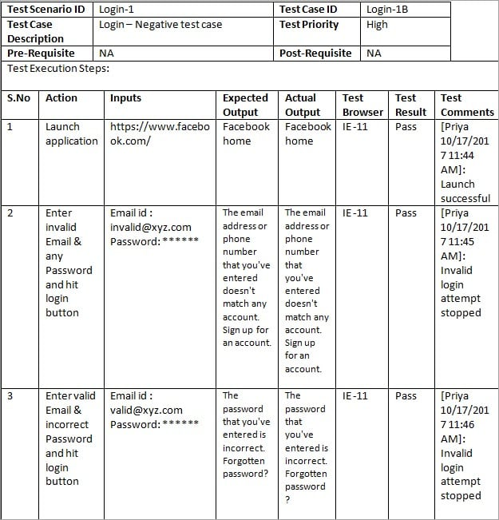
Example (Test case)

Slide 84
THE SOFTWARE LIFE CYCLE
Begins when an application is first conceived.
Ends when it is no longer in use.
Includes:
Initial conception
Requirements/ specification analysis
Functional design
Internal design
Documentation planning
Test planning
Coding
Documenting
Integration
Testing
Maintenance
Updates
Retesting
Phase-out
Many different models are possible for sequencing
these activities!

Slide 85
Activities in SDLC
Project Planning
Analysis
Design
Implement
Test
Roll-out
Initiate project & Organize
UI Design
User Req’ts
Req’ts Analysis
Project Definition & Planning
Technical Design
Detailed Design
Perform Integration Test
Perform System Test
Coding
Convert Site
Quality Requirements
Management Review & Approval
Quality Verification
Test Planning & Preparation
User Procedure & Training
Roll-out Planning & Preparation

Slide 86
Waterfall Model with Prototyping
Requirements Analysis
System Design
Program Design
Coding Unit Test
Integration Testing
Prototyping
System Testing
User/Customer
Acceptance Testing
Operation maintenance

Slide 87
Rapid Application Development (RAD) - V Model
Operation maintenance
Validate requirements
Requirements Analysis
Acceptance Testing
System Design
System Testing
Verify design
Program Design
Unit Test Integration Testing
Design/Analysis
Verify/testing
Coding

Slide 88
VERIFICATION
The process of evaluating a system or component during the development process to determine whether it satisfies the specifications.
THE CRITICAL QUESTION IS:
- Did we build what we planned to build?
Typically involves reviews and meetings to evaluate:
documents
plans
code
requirements
specifications

Slide 89
VALIDATION
The process of evaluating a system or component during the development process to determine whether it satisfies the user's requirements
THE CRITICAL QUESTION IS
“Did we build what the user wanted?”

Slide 90
Verification vs. Validation
Verification confirms that the software meets its specification.
- Are we building the product right？
Validation confirms that the software meets the user’s requirements.
- Are we building the right product ?
Never assume the specifications are correct when testing, Both V&V tests must be performed.
Example: The mirror of Hubble Space Telescope was ground incorrectly (because the specs were wrong) and, consequently, it failed to produce clear pictures when originally launched.

Slide 91
Principle of Testing
?
Which one sounds correct …
Testing is the process of demonstrating that errors are not present.
The purpose of testing is to show that a program performs its intended functions correctly.
Testing is the process of executing a program with the intent of finding errors.
Testing is the process of establishing confidence that a program does what it is supposed to do.

Slide 92
Principle of Testing
Software process models are an ideal … not reality
No software development effort follows a process model perfectly. Why?
The specification never corresponds to the customers needs perfectly.
There is never enough time to perform all of the testing.
Nevertheless, an ideal model is helpful to make progress.
Trade offs and concessions are inevitable.

Slide 93
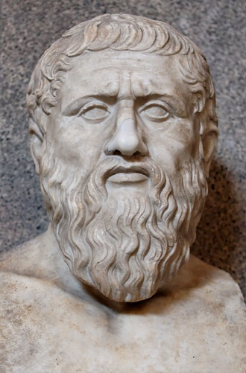
Principle of Testing
Plato had some interesting things to say about the ideal
Physical objects and physical events are shadows of their ideal or perfect forms
They exist only to the extent that they instantiate the perfect versions of themselves.
However, real physical objects are fleeting phenomena, the ideals of which they are mere instances.
Plato believed in perfect justice, perfect chairs, etc.
He would have also believed that the Waterfall model (or some variant of it) was a perfect process model :-)
427 – 347 B.C.

Slide 94
Principle of Testing
Software testing axioms
It is impossible to test a program completely.
Software testing is a risk-based exercise.
Testing cannot show the absence of bugs.
The more bugs you find, the more bugs there are.
Not all bugs found will be fixed.
It is difficult to say when a bug is indeed a bug.
Specifications are never final.
Software testers are not the most popular members of a project.
Software testing is a disciplined and technical profession.

Slide 95
Principle of Testing
Parenthesis: What is an axiom anyway?
An axiom is a sentence or proposition that is not proved or demonstrated and is considered as obvious or as an initial necessary consensus for a theory building or acceptation.
Therefore, it is taken for granted as true, and serves as a starting point for deducing and inferring other (theory dependent) truths.

Slide 96

Principle of Testing
Peano’s axioms for the structure of natural numbers
1 is a natural number.
Every natural number is equal to itself (equality is reflexive).
For all natural numbers a and b, a = b if and only if b = a (equality is symmetric).
For all natural numbers a, b, and c, if a = b and b = c then a = c (equality is transitive).
If a = b and b is a natural number then a is a natural number.
If a is a natural number then successor(a) is a natural number.
If a and b are natural numbers then a = b if and only if successor(a) = successor(b).
If a is a natural number then successor(a) is not equal to 1.
For every set K, if 1 is in K, and successor(x) is in K for every natural number x in K, then every natural number is in K.

Slide 97
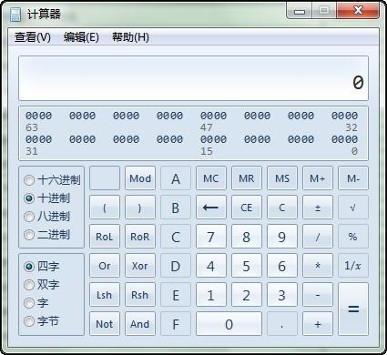
Principle of Testing
Axiom 1 It is impossible to test a program completely
How many test cases do you need to exhaustively test:
Powerpoint
A calculator
MS Word
Any interesting software!
The only way to be absolutely sure software works is to run it against all possible inputs and observe all of its outputs …
Oh, and the specification must be correct and complete.

Slide 98
Principle of Testing
Axiom 1 (cont’d) It is impossible to test a program completely
The number of possible inputs is very large.
The number of possible outputs is very large.
The number of paths through the software is very large.
The software specification open to interpretation.

Slide 99
Principle of Testing
Axiom 2 Software testing is a risk-based exercise
If you do not test the software for all inputs (a wise choice) you take a risk.
Hopefully you will skip a lot of inputs that work correctly.
What if you skip inputs that cause a fault?
Risk: financial loss, security, loss of money, loss of life!
That is a lot of pressure for a tester!
This course is all about techniques and practices to help reduce the risk without breaking the bank.

Slide 100
Principle of Testing
Axiom 2 (cont’d) Software testing is a risk-based exercise
If you try to test too much, the development cost becomes prohibitive.
If you test too little, the probability of software failure increases and as we discussed … software failures can cost us big time!
Number of
Missed Bugs
Cost of
Testing
Quantity
Under
Testing
Testing
Equilibrium
Over
Testing
Amount of Testing

Slide 101
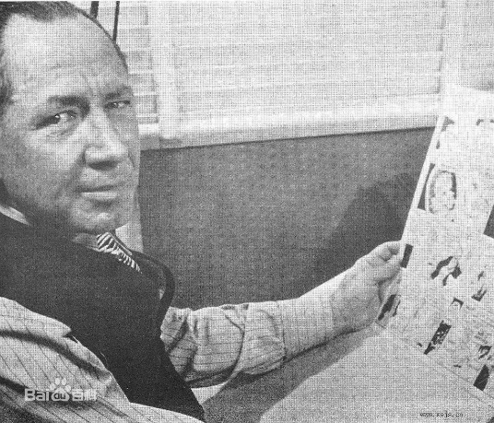
Principle of Testing
Axiom 2 (cont’d) Software testing is a risk-based exercise What about Murphy’s Law?
"If there's more than one possible outcome of a job or task, and one of those outcomes will result in disaster or an undesirable consequence, then somebody will do it that way.”
The law's name stems from an attempt to use new measurement devices developed by one Edward Murphy.
The phrase was coined in reaction to something Murphy said when his devices failed to perform and was eventually cast into its present form prior to a press conference months later.

Slide 102

Principle of Testing
Axiom 3 Testing cannot show the absence of bugs
“Program testing can be used to show the presence of bugs, but never to show their absence!” - Edsger Wybe Dijkstra
Dijkstra received the 1972 ACM Turing Award for fundamental contributions in the area of programming languages

Slide 103

Principle of Testing
Axiom 4 The more bugs you find, the more bugs there are
Bugs appear in groups, where you see one you will likely find more … Why?
Programmers can have bad days
Programmers tend to make the same mistakes
Some bugs are just the tip of the iceberg.
Boris Beizer coined the term pesticide paradox to describe the phenomenon that the more you test software the more immune it becomes to your test cases.
Remedy: continually write new and different tests to exercise different parts of the software.

Slide 104
Principle of Testing
Axiom 5 Not all bugs found will be fixed
Why wouldn’t you fix a bug you knew about?
There’s not enough time
Some deadlines cannot be extended (e.g., Y2K)
It’s not really a bug
Specifications can be wrong
It’s too risky to fix
“I’m not touching Murphy’s code!”
It’s just not worth it
Bugs in fringe features may have to wait
Why not charge the customer for bug fixes in the next release (sound familiar?) :-)

Slide 105
Principle of Testing
Axiom 6 It is difficult to say when a bug is indeed a bug
If there is a problem in the software but no one ever discovers it … is it a bug?
Parody of “if a tree falls in the forest … does it really make a noise?”
What is your opinion? Does a bug have to be observable in order for it to be a bug?
Bugs that are undiscovered are called latent bugs.

Slide 106
Principle of Testing
Axiom 7 Specifications are never final
Building a product based on a “moving target” specification is fairly unique to software development.
Competition is fierce
Very rapid release cycles
Software is “easy” to change
Not true in other engineering domains
E.g., the Brooklyn Bridge could not be adjusted to allow train traffic to cross it once its construction started.

Slide 107
Principle of Testing
Axiom 8 Software testers are not the most popular members of a project
Goal of a software tester:
Find bugs
Find bugs early
Make sure bugs get fixed
Tips to avoid becoming unpopular:
Find bugs early
Temper your enthusiasm … act in a professional manner
Don’t report just the bad news

Slide 108
Principle of Testing
Axiom 9 Software testing is a disciplined and technical profession
When software was simpler and more manageable software testers were often untrained and testing was not done methodically.
Contrary to the urban legend, if you hire a million moneys and have them test for a million years … you will not find all of the bugs in your software.
It is now too costly to build buggy software.
As a result testing has matured as a discipline.
Sophisticated techniques
Tool support
Rewarding careers

Slide 109
Principle of Testing
Some Terminology
Verification
“Are we building the product right?”
Does the software meet the specification?
Validation
“Are we building the right product?”
Does the software meet the user requirements?
Software Quality Assurance
Not the same as software testing …
Create and enforce standards and methods to improve the development process and to prevent bugs from occurring.

Slide 110
Principle of Testing
You now know …
… the 9 axioms of software testing
… what is software verification
… what is software validation
… the relationship between software quality and reliability
… the relationship between testing and quality assurance

Slide 111
16 Weeks Plan
Week 1: The basic concepts and theories of testing
Week 2-3: Principles of Testing
Week 4-5: White Box Testing
Week 6-7: Test Cases & Black Box Testing
Week 8: Usability Testing
Week 9: Mutation Testing & Finite Automata
Week 10: Mid-term Review and System Testing
Week 11: Empirical Software Testing
Week 12: Interaction System Testing
Week 13-14: ML & AI System Testing
Week 15-16: Conclusion & General Review

Slide 112
Project
Software for detecting code similarity
Requirement:
String matching
Control flow similarity
Data flow similarity
Overall Rating
References:
MOSS（Measure Of Software Similarity）--Stanford
Github

Slide 113
TESTING FUNDAMENTALS EXAMINING THE CODE

Slide 114

Examine the Design Documents & Code
These are static, white box techniques.
Handling these requires some programming expertise.
It is best if the testers know the language in which the software is written.
Consequently, you often find these tests are run by either Programmers with software testers as observers or Software testers with help from the programmers.

Slide 115
Major Problems with These Tests
They are often NOT performed!
These are the hardest to justify to upper management as they are viewed by many as too time consuming.
Some of the problem is the perception that programmers are not productive if they are not generating code.
Note: The tyranny of the LOC metric, Lines of executable code as a measure of productivity!

Slide 116
Three approaches
Formal inspection
Peer review
Walkthrough
Informal
Formal
Peer desk check Walkthrough Inspection

Slide 117
FORMAL REVIEWS
These are structured processes for doing static, white box testing.
4 elements are required:
1. Identify problems by directing attention to the code, not who wrote it.
2. Setup and follow rules for the review:
- How much code should be examined?
- How long should the review take?
- What is fair game for the review?
3. Prepare and assign duties to people
Moderator, recorder, reader, etc.
4. Write a report.
These are not just “get together and go over code” sessions!

Slide 118
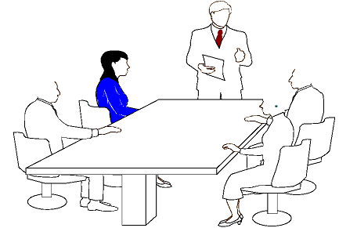
Formal Reviews - Formal inspection
1. Well-defined roles and responsibilities
2. Well-defined steps
Overview
Preparation
Inspection
Rework
Meeting
Follow-up

Slide 119
Typically, different levels of formality identify the kind of formal review:
Peer (or Buddy) Review:
Most informal.
Involves a coder and a few buddies.
Still be sure all 4 elements are present.
Walkthroughs:
Next step in formality.
The programmer works with a small group of ~5 programmers and testers.
Everyone has copies of the code in advance.
A presenter “reads” the code line-by-line, function by function, saying what is done and why it is being done.

Slide 120
Example in a Walkthrough
Consider
for (i = 1; i < n; i++)
cout << a[i] << endl;
cout << i << endl;
Reader explains
That i is the index of an array named a.
The variable n is initialized elsewhere (and identifies where).
The loop outputs values for a[1], a[2], ..., a[i-1].
Questions raised:
Where does the variable i get a value for the last line?
Does the programmer expect the output value for i to be inside the loop?

Slide 121
Inspections
Most formal of the reviews.
Very highly structured.
The agenda and code to consider is available in advance of the meeting.
The presenter or reader isn’t one of the programmers.
All the other people are inspectors playing different roles. Examples are
- User
- Tester
- Product support person
- Have a moderator and a recorder.

Slide 122
Goal of All of the Formal Reviews
Look for problems and omissions in the code.
May check also to see if the code is written to adhere to pre-specified standards or guidelines.
There is a lot of literature on how formal reviews should be conducted.
Most companies that use them develop their own checklists.

Slide 123
Standards and Guidelines
Be careful not confuse these with style considerations.
Indenting rules are about style, not something that affects whether a program is correct or not.
Examples of standards or guidelines:
- Don’t use GOTOs
- Use WHILE loops, instead of DO-WHILE loops except in rare cases.

Slide 124
Examples
Visual Basic Coding Standards by Phil Fresle
Copyright 2000 Frez Systems Limited
Last updated 17-Apr-2000
Introduction Naming Conventions Use of Variables, Procedures and Constants Commenting Code Formatting Code Other Coding Rules Sample Boilerplates Sample Code Containing Error Handling Further Reading
Introduction
These are the Visual Basic coding standards used by Frez Systems Limited.

Slide 125
Another Example
1. Foreword
2. Release Note
3. Commentary in file
4. Constant
5. Variable
6. Struct/Enum definition
7. Expression and code blocks
8. Some good habit

Slide 126
Why Use Standards or Guidelines
Studies show they increase
Reliability
Readability and, hence, maintainability
Portability
Some contractors require that certain standards be used when developing software for them.
Good example- the government

Slide 127
Organizations Producing Various Standards and Guidelines
ANSI – American National Standards Institute
IEC – International Engineering Consortium
ISO – International Organization for Standardization
NCITS – National Committee for Information Technology Standards
Plus various professional organizations
ACM – Association for Computing Machinery
IEEE – Institute of Electrical and Electronic Engineering
Plus some of the testing organizations which we will consider later produce some standards for testing processes.

Slide 128
One list to check while doing formal reviews (from the text) :
Data reference errors.
Data declaration errors.
Computation errors.
Comparison errors.
Control flow errors.
Subroutine (or function) parameter errors.
I/O errors
Miscellaneous

Slide 129
TESTING FUNDAMENTALS
TESTING THE SOFTWARE
WITH X-RAY GLASSES

Slide 130
Test thoroughness
Test code thoroughly, one of several approaches based on data manipulated by the code:
Statement testing: every statement is executed at least once in some test
Branch testing
Path testing
Definition-use path testing
All uses testing
Statement, Path, Use

Slide 131
Examples
Pointer=False
1
Paths:
1-2-3-4-5-6-7
1-2-3-4-5-6-1
1-2-4-5-6-7
1-2-4-5-6-1
2
X>K?
Yes
Pointer = True
3
No
X=X+1
4
Call Sub (x, pointer, result)
5
6
Result>0?
Yes
Print result
7
No

Slide 132
Dynamic, White Box Testing
What many people think of when you mention testing.
But, note all the other possibilities we have already examined.
Control Flow Testing also called structural testing.
Control-flow testing techniques are based on judiciously selecting a set of test paths through the program.
The set of paths chosen is used to achieve a certain measure of testing thoroughness.
E.g., pick enough paths to assure that every source statement is executed as least once.
Techniques here are not limited to just examining the code, but involve directly controlling the software.

Slide 133
Overview of the Areas of Dynamic, White Box Testing
Directly test the pieces--- the low-level functions, procedures, subroutines or libraries.
Do top level testing of the completed program, but choose test cases by knowledge of the code.
Directly access variables and state information and force the software to do things.
Measure how much of the code has been tested and be able to adjust your tests to remove redundant test cases and add missing ones.
CAUTION: Be careful to not confuse testing with debugging!
When you try to correct bugs, you are debugging. Normally, programmers debug.

Slide 134
Debugging plays a role
We see this even with compiler errors.
Consequently, testing requires that debugging be done quickly after some bugs are found.
Remember, the earlier a bug is found, the cheaper it is to fix. Bugs often mask other bugs
Always remember that creating black-box test cases based on specs is important as these expose misinterpreted ideas, which can’t be found by white-box testing.
Dynamic
White-box
Testing
Debugging
Isolating
the bug
Testing
Programming

Slide 135
White-Box Testing
Basic Path Testing
exercise each independent path at least once
Condition Testing
exercise all logical conditions on their true and false sides
Loop Testing
execute all loops at their boundaries and within their bounds
Data Flow Testing
exercise all data structures to ensure their validity

Slide 136
Basic Path Testing
Goal: exercise each independent path at least once.
Using the code, draw a corresponding flow graph (First drawing the activity diagram for the code may help, but is not required)
Determine the cyclomatic complexity of the flow graph.
Determine a basis set of linearly independent paths.
Prepare test cases that force the execution of each path in the basis set.

Slide 137
Flow graph from code
Flow graphs Consist of Three Primitives
A decision is a program point at which the control can diverge.
(e.g., if and case statements).
A junction is a program point where the control flow can merge.
(e.g., end if, end loop, goto label)
A process block is a sequence of program statements uninterrupted by either decisions or junctions. (i.e., straight-line code).
A process has one entry and one exit.
A program does not jump into or out of a process.

Slide 138
Flow graph from code
.
.
.
Sequence
If-then-else
Case
Do-until
Do-while

Slide 139
Binary search (Java)

Slide 140
Binary search flow graph

Slide 141
Basis path test
A path through a program is a sequence of statements that starts at an entry, junction, or decision and ends at another (possible the same), junction, decision, or exit.
A path may go through several junctions, processes, or decisions, one or more times.
Paths consist of segments.
The smallest segment is a link. A link is a single process that lies between 2 nodes.
The length of a path is the number of links in a path.
An entry/exit path or a complete path is a path that starts at a routine’s entry and ends at the same routine’s exit.
1
2
3
4

Slide 142
Basis path test
Complete paths are useful for testing because:
It is difficult to set up and execute paths that start at an arbitrary statement.
It is difficult to stop at an arbitrary statement without changing the code being tested.
We think of routines as input/output paths.
Path Selection Criteria
There are many paths between the entry and exit points of a typical routine.
Even a small routine can have a large number of paths.

Slide 143
Example
Procedure: process records
1. Do While records remain
2. Read record;
3. If record field 1 = 0 Then
4. store in buffer;
5. increment counter;
6. Else If record field 2 = 0 Then
7. reset counter;
8. Else store in file;
9. End If
10. End If
11. End Do
End

Slide 144
Example (continued)
Procedure: process records
1. Do While records remain
2. Read record;
3. If record field 1 = 0 Then
4. store in buffer;
5. increment counter;
6. Else If record field 2 = 0 Then
7. reset counter;
8. Else store in file;
9. End If
10. End If
11. End Do
End
1
2
3
6
4
8
7
9
5
10
11
V(G) = 4

Slide 145
Basis path test example: FLOW GRAPH
1
2,3
6
4,5
8
7
9
10
11

Slide 146
Determine cyclomatic complexity of flow graph
Cyclomatic complexity: a quantitative measure of the logical complexity of code, provides an upper bound on the number of paths that need to be tested in the code
modules
Higher Cycloramic Complexity, more possibility in error
V(G)
modules in this range are more error prone
V(G) =number of regions (areas bounded by nodes and edges—area outside the graph is also a region)
V(G) = number of edges - the number of nodes + 2
V(G) = number of (simple) predicate nodes + 1
Notes:
2. Determine the cyclomatic complexity of the resultant flow graph
Note: can be determined without developing a flow graph
count all conditional statements in a component
→ compound conditions count as 2
(number of Boolean operators + 2)

Slide 147
Basis path test example : FLOW GRAPH
1
Region 1
Region 4
2,3
6
4,5
Region 2
7
Region 3
8
9
10
V(G)=4
11

Slide 148
Determine a basis set of linearly independent paths
Independent path ® any path that introduces at least one new set of processing statements or a new condition
Basis set ® set of independent paths through the code
Test cases derived from a basis set are guaranteed to execute every statement at least one time during testing
Basis set is not unique
Notes:
3. Determine a basis set of linearly independent paths
equal to cyclomatic complexity number
identify predicate nodes as an aid in derivation of test cases

Slide 149
Basis path test example
Path1: 1-2-3-6-7-9-10-1-11
1
2
Path2: 1-2-3-6-8-9-10-1-11
3
6
4
Path3: 1-2-3-4-5-10-1-11
7
8
9
5
11
10
Path4: 1-11

Slide 150
Basis path test example
1 scanf(“%d %d”,&x, &y);
2 if (y < 0)
3 pow = -y;
4 else
5 pow = y;
6 z = 1.0;
7 while (pow != 0) {
8 z = z * x;
9 pow = pow - 1;
10 }
11 if (y < 0)
12 z = 1.0 / z;
13 printf (“%f”,z);

Slide 151
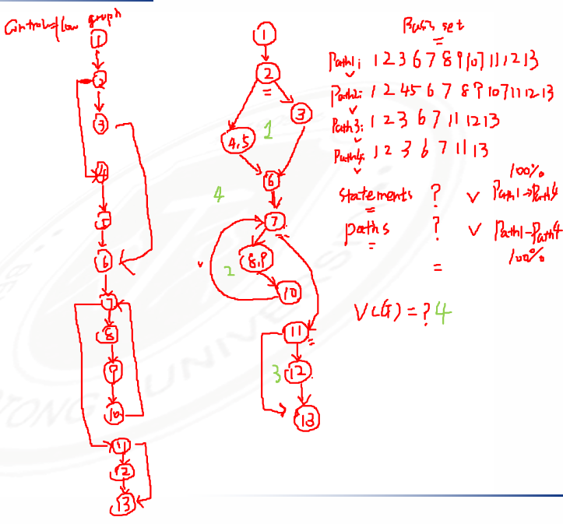
Review: Basis path test example
1 scanf(“%d %d”,&x, &y);
2 if (y < 0)
3 pow = -y;
4 else
5 pow = y;
6 z = 1.0;
7 while (pow != 0) {
8 z = z * x;
9 pow = pow - 1;
10 }
11 if (y < 0)
12 z = 1.0 / z;
13 printf (“%f”,z);

Slide 152
Basis path test example
for (j=1; j<N; j++)
{
3 last = N - j + 1;
4 for (k=1; k<last; k++)
5 {
6 if (list[k] > list[k+1])
7 {
8 temp = list[k];
9 list[k] = list[k+1];
10 list[k+1] = temp;
11 }
12 }
13 }
14 print(“Done\n”);

Slide 153
Basis path test example
for (j=1; j<N; j++)
{
3 last = N - j + 1;
4 for (k=1; k<last; k++)
5 {
6 if (list[k] > list[k+1])
7 {
8 temp = list[k];
9 list[k] = list[k+1];
10 list[k+1] = temp;
11 }
12 }
13 }
14 print(“Done\n”);

Slide 154
Basis path test example
1 main(int argc, char *argv[])
2 {
3 int numChars = 0;
4 int numLines = 0;
5 char chr;
6 FILE *fp = NULL;
7
8 if (argc < 2)
9 {
10 printf(“\nUsage: %s <filename>”, argv[0]);
11 return (-1);
12 }
13 fp = fopen(argv[1], “r”);
14 if (fp == NULL)
15 {
16 perror(argv[1]); /* display error message */
17 return (-2);
18 }
19 while (!feof(fp))
20 {
21 chr = getc(fp); /* read character */
22 if (chr == ‘\n’) /* if carriage return */
23 ++numLines;
24 else
25 ++numChars;
26 }
27 printf(“\nNumber of characters = %d”, numChars);
28 printf(“\nNumber of lines = %d”, numLines);
29 }

Slide 155
Basis path test example
/* COUNT
This program counts the number of characters and lines in a text file.
INPUT: Text File
OUTPUT: Number of characters and number of lines.
*/
1 main(int argc, char *argv[])
2 {
3 int numChars = 0;
4 int numLines = 0;
5 char chr;
6 FILE *fp = NULL;
7
8 if (argc < 2)
9 {
10 printf(“\nUsage: %s <filename>”, argv[0]);
11 return (-1);
12 }
13 fp = fopen(argv[1], “r”);
14 if (fp == NULL)
15 {
16 perror(argv[1]); /* display error message */
17 return (-2);
18 }
19 while (!feof(fp))
20 {
21 chr = getc(fp); /* read character */
22 if (chr == ‘\n’) /* if carriage return */
23 ++numLines;
24 else
25 ++numChars;
26 }
27 printf(“\nNumber of characters = %d”, numChars);
28 printf(“\nNumber of lines = %d”, numLines);
29 }

Slide 156
Basis path test example
1. function radixSort(arr, maxDigit) {
2. varmod = 10;
3. vardev = 1;
4. for(vari = 0; i < maxDigit; i++, dev *= 10, mod *= 10) {
5. for(varj = 0; j < arr.length; j++) {
6. varbucket = parseInt((arr[j] % mod) / dev);
7. if(counter[bucket]==null) {
8. counter[bucket] = [];
9. }
10. counter[bucket].push(arr[j]);
11. }
12. varpos = 0;
13. for(varj = 0; j < counter.length; j++) {
14. varvalue =null;
15. if(counter[j]!=null) {
16. while((value = counter[j].shift()) !=null) {
17. arr[pos++] = value;
18. }
19. }
20. }
21. }
22. return arr;
23. }

Slide 157
Test cases to execute each path in the basis set
you do not need an activity diagram, but the picture will help when you trace component paths
count each logical test—compound tests count as the number of Boolean operators + 1 (i.e., count each simple predicate)
basis path testing should be applied to all components, if possible, and to critical components always
Basis path testing does not test all possible combinations of all paths through the code; it just tests every path at least once.
Notes:
4. Prepare test cases that will force execution of each path in the basis set
each test case is executed and compared to the expected result
this process can be mechanized

Slide 158
Condition testing
Goal: further exercises the true and false value of each simple logical condition in a component.
Logical conditions
Simple condition: (a rel-op b) where rel-op={<, ≤, =, ≠, ≥, >} (may be negated with NOT), e.g., a≤b; NOT(a≤b)
Compound condition: two or more simple conditions connected with AND, OR, e.g., (a>b) AND (c<d)
Relational expression: (E₁ rel-op E₂) where E₁ and E₂ are arithmetic expressions, e.g., ((a*b+c)>(a+b+c))
errors to test for include (incorrect/missing/extra):
Boolean operator – relational operator
Boolean variable – arithmetic expression
Boolean parenthesis

Slide 159
Condition testing (2)
Branch testing
for a compound condition C, test true and false branches of C and every simple condition of C
e.g., for C = (a>b) AND (c<d) test:
a>b TRUE, FALSE
c<d TRUE, FALSE
C TRUE, FALSE
True AND True
T. And F., F. And T.,
F. And F.
Domain testing
for an expression E₁ rel-op E₂, test for E₁ ≧ ≦ = < > ≠ E₂
guarantees detection of rel-op error if E₁ and E₂ are correct
to detect errors in E₁ / E₂, the difference between E₁ and E₂ for the tests E₁ < or > than E₂ should be as small as possible
for an expression with n variables, 2^{n} tests are required

Slide 160
Condition Testing-Example
start
But ( i = result = 0 ) :
maxint N i<N result<=maxint
-1 1 true false
1 0 false true
gives condition coverage for all conditions
N < 0
yes
N := -N;
no
i:=i+1;
result:=result+i;
(i<N) and
(result<=maxint)
yes
But it does not preserve decision coverage ⇓
always take care that condition coverage preserves decision coverage :
decision / condition coverage
no
yes
no
result<=maxint
output(result);
output(too large);
exit

Slide 161
Branch Testing
Branch Coverage
Execute the enough test cases，attempting to cover all the paths in the software:
- Get both “True” and “False”
- Go through each branch。
For example
IF b THEN s1 ELSE s2
CASE x OF 1 : …. 2 : …. 3 : ….

Slide 162
Branch Testing - Example
1 PROGRAM som ( maxint, N : INT )
2 INT result := 0 ; i := 0 ;
3 IF N < 0
4 THEN N := - N ;
5 WHILE ( i < N ) AND ( result <= maxint )
6 DO i := i + 1 ;
7 result := result + i ;
8 OD;
9 IF result <= maxint
10 THEN OUTPUT ( result )
11 ELSE OUTPUT ( “too large” )
12 END.

Slide 163
Branch Testing - continued
start
Tests for complete statement coverage: maxint N
10 -1
0 -1
is not sufficient for branch coverage;
result=0 i=0
N < 0
yes
N < 0
N := -N;
no
(N>=0)
i:=i+1;
result:=result+i;
(i<N) and
(result<=maxint)
yes
Take:
maxint N
10 3
0 -1
for complete branch coverage
no
yes
result<=maxint
no
output(result);
output(too large);
exit

Slide 164
Control Flow Testing
How do we define “complete” testing?
1) Exercise every path from entry to exit.
2) Exercise every statement at least once.
3) Exercise every branch (in each direction) at least once.
Clearly, 1 implies 2 and 3
However, 1 is impractical for most routines.
Also, 2 is not equal to 3 in languages with goto statements.

Slide 165
Control Flow Testing
Demonstration that 2 does not imply 3
Correct Code
1 if (x >= 0 ) {
x = x + A;
}
2 x = x + A
2.Statement Coverage: For x < 0 the program produces the correct result AND every statement has been executed.
3.Branch Coverage:
Would have found the bug! Therefore 2 does not imply 3.
1
2
Buggy Code
1 if (x >= 0 ) {
/* missing statement */
}
2 x = x + A

Slide 166
Control Flow Testing
Demonstration that 3 Does not Imply 2
1 if (x < 0) {
2 goto 200;
x = x + A
} else
x = x + B
3 200: x = x + C
Branch Coverage: Does not exercise dead code. Therefore 3 does not imply 2.
However, 3 implies 2 for programs written in a structured programming language without goto statements.
1
2
3

Slide 167
Control Flow Testing
Control-flow Testing Criteria
We have explored 3 testing criteria from an infinite set of strategies:
1) Path Testing ( ):
100% path coverage.
Execute all possible control flow paths through the program.

Slide 168
Control Flow Testing
Control-flow Testing Criteria (Cont’d)
2) Statement Testing ( ):
100% statement coverage.
Execute all statements in a program at least once under some test.
3) Branch Testing ( ):
100% branch coverage.
Execute enough tests to assure that every branch alternative has been exercised at least once under some test.

Slide 169
Data Flow Testing

Slide 170
Data Flow
Beyond structure
Goal: Try to ensure that values are computed and used correctly
1
2
3
4
5
6
7
8

Slide 171
Data Flow
Definition (def) : A location where a value for a variable is stored into memory
Use : A location where a variable’s value is accessed
Z = X*2
Defs: def (1) = {X}
def (5) = {Z}
def (6) = {Z}
Uses: use (5) = {X}
use (6) = {X}
X = 42
2
5
1
4
7
3
6
Z = X-8
The values given in defs should reach at least one, some, or all possible uses

Slide 172
Define and Use
(def) Defined Objects
An object (e.g., variable) is defined when it:
appears in a data declaration
is assigned a new value
is a file that has been opened
is dynamically allocated
...
(use) Used Objects
An object is used when it is part of a computation or a predicate.
A variable is used for a computation (c) when it appears on the RHS (Right Hand Side) of an assignment statement.
A variable is used in a predicate (p) when it appears directly in that predicate.

Slide 173
Sets of Def and Use
def (n) or def (e) : The set of variables that are defined by node n or edge e
use (n) or use (e) : The set of variables that are used by node n or edge e
DU pair : A pair of locations (l_{i}, l_{j}) such that a variable v is defined at l_{i} and used at l_{j}
Def-clear : A path from l_{i} to l_{j} is def-clear with respect to variable v if v is not given another value on any of the nodes or edges in the path
Reach : If there is a def-clear path from l_{i} to l_{j} with respect to v, the def of v at l_{i} reaches the use at l_{j}

Slide 174
DU Path
du-path : A simple subpath that is def-clear with respect to v from a def of v to a use of v
du (n_{i}, n_{j}, v) the set of du-paths from n_{i} to n_{j}
du (n_{i}, v) the set of du-paths that start at n_{i}

Slide 175
Data Flow Coverage Criteria
All-defs coverage (ADC) : For each set of du-paths S = du (n, v), TR contains at least one path d in S.
All-uses coverage (AUC) : For each set of du-paths to uses S = du (n_{i}, n_{j}, v), TR contains at least one path d in S.
All-du-paths coverage (ADUPC) : For each set S = du (n_{i}, n_{j}, v), TR contains every path d in S.

Slide 176
Data Flow Testing
Z = X*2
X = 42
2
5
1
4
7
3
6
Z = X-8
All-defs for X
[ 1, 2, 4, 5 ]
All-uses for X
[ 1, 2, 4, 5 ]
[ 1, 2, 4, 6 ]
All-du-paths for X
[ 1, 2, 4, 5 ]
[ 1, 3, 4, 5 ]
[ 1, 2, 4, 6 ]
[ 1, 3, 4, 6 ]

Slide 177
Data Flow Testing
Example 1 (If condition):
What are the All-defs, All-uses, All-du-Paths for the program below?
1: read (z)
2: x = 0
3: y = 0
4: if (z ≥ 0)
5: {
6: x = sqrt (z)
7: if (0 ≤ x && x ≤ 5)
8: y = f (x)
9: else
10: y = h (z)
11: }
12: y = g (x, y)
13: print (y)

Slide 178
Data Flow Testing
Example 2 (If + Loop):
What are the All-defs, All-uses, All-du-Paths for the program below?

Slide 179
Example 3 (If + For Loop):
What are the All-defs, All-uses, All-du-Paths for the program below?
1
2
3
4
5
6
7
8
9
10
11
12
13
14
15
16
17
18
19
20
public static void CSta (int [ ] numbers)
{
int length = numbers.length;
double var, mean, sum, varsum;
sum = 0.0;
for (int i = 0; i < length; i++)
{
sum += numbers [ i ];
}
mean = sum / length;
varsum = 0.0;
for (int i = 0; i < length; i++)
{
varsum = varsum + ((numbers [i] - mean) * (numbers [i] - mean));
}
var = varsum / ( length - 1.0 );
System.out.println ("length: " + length);
System.out.println ("mean: " + mean);
System.out.println ("variance: " + var);
}

Slide 180
Control Flow Graph
public static void CSta (int [ ] numbers)
{
int length = numbers.length;
double var, mean, sum, varsum;
sum = 0.0;
for (int i = 0; i < length; i++)
{
sum += numbers [ i ];
}
mean = sum / length;
varsum = 0.0;
for (int i = 0; i < length; i++)
{
varsum = varsum + ((numbers [i] - mean) * (numbers [i] - mean));
}
var = varsum / ( length - 1.0 );
System.out.println ("length: " + length);
System.out.println ("mean: " + mean);
System.out.println ("variance: " + var);
}
1
2
3
4
5
6
7
8

Slide 181
If we use less states ?
public static void CSta (int [ ] numbers)
{
int length = numbers.length;
double var, mean, sum, varsum;
sum = 0.0;
for (int i = 0; i < length; i++)
{
sum += numbers [ i ];
}
mean = sum / length;
varsum = 0.0;
for (int i = 0; i < length; i++)
{
varsum = varsum + ((numbers [i] - mean) * (numbers [i] - mean));
}
var = varsum / ( length - 1.0 );
System.out.println ("length: " + length);
System.out.println ("mean: " + mean);
System.out.println ("variance: " + var);
}
1
2
1
3
def (1) = { numbers, sum, length }
4
5
2
def (2) = { i }
6
7
3
use (3, 5) = { i, length }
8
use (3, 4) = { i, length }
4
5
def (5) = {mean, varsum, i }
use (5) = {length, sum }
def (4) = { sum, i }
use (4) = { sum, numbers, i }
6
use (6, 7) = { i, length }
use (6, 8) = { i, length }
7
8
def (7) = { varsum, i }
use (7) = { varsum, numbers, i, mean }
def (8) = { var}
use (8) = {varsum, length, mean, var}

Slide 182
Variable List of Nodes
Node | Def | Use
1 | { numbers, sum, length } | { numbers }
2 | { i }
3
4 | { sum, i } | { numbers, i, sum }
5 | {mean, varsum, i } | { numbers, length, sum }
6
7 | { varsum, i } | { varsum, numbers, i, mean }
8 | {var} | {length, mean, var}
1
2
3
4
5
6
7
8

Slide 183
Variable List of Edges
1
Edge | Use
(1, 2)
(2, 3)
(3, 4) | { i, length }
(4, 3)
(3, 5) | { i, length }
(5, 6)
(6, 7) | { i, length }
(7, 6)
(6, 8) | { i, length }
2
3
4
5
6
7
8

Slide 184
DU-Paths
1
def (1) = { numbers, sum, length }
variable | DU Pairs | DU Paths
numbers | (1, 4) (1, 5) (1, 7) | [ 1, 2, 3, 4 ] [ 1, 2, 3, 5 ] [ 1, 2, 3, 5, 6, 7 ]
length | (1, 5) (1, 8) (1, (3,4)) (1, (3,5)) (1, (6,7)) (1, (6,8)) | [ 1, 2, 3, 5 ] [ 1, 2, 3, 5, 6, 8 ] [ 1, 2, 3, 4 ] [ 1, 2, 3, 5 ] [ 1, 2, 3, 5, 6, 7 ] [ 1, 2, 3, 5, 6, 8 ]
var | (8, 8) | No path needed
sum | (1, 4) (1, 5) (4, 4) (4, 5) | [ 1, 2, 3, 4 ] [ 1, 2, 3, 5 ] [ 4, 3, 4 ] [ 4, 3, 5 ]
2
def (2) = { i }
3
use (3, 5) = { i, length }
use (3, 4) = { i, length }
4
5
def (5) = {mean, varsum, i }
use (5) = { numbers, length, sum }
def (4) = { sum, i }
use (4) = { sum, numbers, i }
6
use (6, 8) = { i, length }
use (6, 7) = { i, length }
7
8
def (7) = { varsum, i }
use (7) = { varsum, numbers, i, mean }
def (8) = { var}
use (8) = {length, mean, var}

Slide 185
DU-Paths
variable | DU Pairs | DU Paths
mean | (5, 7) (5, 8) | [ 5, 6, 7 ] [ 5, 6, 8 ]
varsum | (5, 7) (5, 8) (7, 7) (7, 8) | [ 5, 6, 7 ] [ 5, 6, 8 ] [ 7, 6, 7 ] [ 7, 6, 8 ]
i | (2, 4) (2, (3,4)) (2, (3,5)) (4, 4) (4, (3,4)) (4, (3,5)) (5, 7) (5, (6,7)) (5, (6,8)) (7, 7) (7, (6,7)) (7, (6,8)) | [ 2, 3, 4 ] [ 2, 3, 4 ] [ 2, 3, 5 ] [ 4, 3, 4 ] [ 4, 3, 4 ] [ 4, 3, 5 ] [ 5, 6, 7 ] [ 5, 6, 7 ] [ 5, 6, 8 ] [ 7, 6, 7 ] [ 7, 6, 7 ] [ 7, 6, 8 ]
1
def (1) = { numbers, sum, length }
2
def (2) = { i }
3
use (3, 5) = { i, length }
use (3, 4) = { i, length }
4
5
def (5) = {mean, varsum, i }
use (5) = { numbers, length, sum }
def (4) = { sum, i }
use (4) = { sum, numbers, i }
6
use (6, 8) = { i, length }
use (6, 7) = { i, length }
7
8
def (7) = { varsum, i }
use (7) = { varsum, numbers, i, mean }
def (8) = { var}
use (8) = {length, mean, var}

Slide 186
DU Paths
38 DU Paths, 12 unique ones
1
[ 1, 2, 3, 4 ]
[ 1, 2, 3, 5 ]
[ 1, 2, 3, 5, 6, 7 ]
[ 1, 2, 3, 5, 6, 8 ]
[ 2, 3, 4 ]
[ 2, 3, 5 ]
[ 4, 3, 4 ]
[ 4, 3, 5 ]
[ 5, 6, 7 ]
[ 5, 6, 8 ]
[ 7, 6, 7 ]
[ 7, 6, 8 ]
2
3
4 expect a loop not to be “entered”
4
5
6 require at least one iteration of a loop
6
2 require at least two iterations of a loop
7
8

Slide 187
Test and Test Paths
One iteration of a loop
Test: numbers = (44)
Test Path: [ 1, 2, 3, 4, 3, 5, 6, 7, 6, 8 ]
DU Paths
[ 1, 2, 3, 4 ] [ 2, 3, 4 ] [ 4, 3, 5 ] [ 5, 6, 7 ] [ 7, 6, 8 ]
1
2
Two iterations of a loop
Test: numbers = (2, 10, 15) ; length = 3
Test Path: [ 1, 2, 3, 4, 3, 4, 3, 4, 3, 5, 6, 7, 6, 7, 6, 7, 6, 8 ]
DU Paths
[ 4, 3, 4 ] [ 7, 6, 7 ]
3
4
5
a loop not to be “entered”
Reveal the bug in the statement
med = numbers [length / 2];
6
Bug
7
8

Slide 188
Exercise 2
1 void Merge(int a[], int left, int mid, int right)
2 {
3 int len = right - left + 1;
4 int *temp = new int[len];
5 int k = 0;
6 int j = mid + 1;
7 while (i <= mid && j <= right)
8 {
9 temp[k++] = a[i] <= a[j] ? a[i++] : a[j++];
10 }
11 while (i <= mid)
12 {
13 temp[k++] = a[i++];
14 }
15 while (j <= right)
16 {
17 temp[k++] = a[j++];
18 }
19 for (int k = 0; k < len; k++)
20 {
21 a[left++] = temp[k];
22 }
23 }

Slide 189
16 Weeks Plan
Week 1: The basic concepts and theories of testing
Week 2-3: Principles of Testing
Week 4-5: White Box Testing
Week 6-7: Test Cases & Black Box Testing
Week 8: Usability Testing
Week 9: Mutation Testing & Finite Automata
Week 10: Mid-term Review and System Testing
Week 11: Empirical Software Testing
Week 12: Interaction System Testing
Week 13-14: ML & AI System Testing
Week 15-16: Conclusion & General Review

Slide 190
OVERVIEW OF CLASSIFYING TESTS
BLACK-BOX: No knowledge of the internal logic of the code is utilized. Tests are based on requirements and functionality.
WHITE-BOX: Tests are designed based on the internal logic of the code, code coverage considerations, and analysis of branches, paths, loops, and conditions
UNIT: Test at the function or module level. May require test drivers or test harnesses.
INCREMENTAL INTEGRATION: Continuous testing as new functionality is added. May need test drivers. Testing combined parts of an application to see if the parts function together properly.
REGRESSION: Re-testing after fixes or modifications of software or the environment.

Slide 191
TEST PHASES
COMPARISON: Compares weaknesses and strengths to competing products.
ALPHA: Testing when development is nearing completion; minor design changes may be required.
BETA: Development and testing viewed as completed and looking for final bugs and problems before final release.

Slide 192
CLASSIFYING TESTS
FUNCTIONAL: Black-box testing geared to check functional requirements of an application.
SYSTEM: Black-box testing that is based on overall requirements and specifications.
STRESS: Often used interchangeably with ‘load’ and ‘performance’. But, others believe tests should check functionality under extreme conditions.
PERFORMANCE: Often used interchangeably with “load” and ‘stress’.
LOAD: Test under heavy loads to determine at what point a system’s response time degrades or fails
END-TO-END: Testing that mimics real-world use.

Slide 193
CLASSIFYING TESTS (continued)
ACCEPTANCE: Final testing based on specifications of the end-user or customer.
USABILITY: Testing for “user-friendliness”. This is clearly subjective and will depend on the targeted end-user or customer profile.
RECOVERY: How well can the system recover from crashes, hardware failures, or other catastrophic problems.
INSTALL/UNINSTALL: Test full, partial, or upgrade install/uninstall processes.
SECURITY: How well is the system able to protect against unauthorized internal or external access, willful damage, etc.
COMPATABILITY: How well does the software perform in a given hardware/software/operating system/network environment.

Slide 194
CLASSIFYING TESTS (summary)
By purposes • Correctness testing – Black-box – White-box • Performance testing • Reliability testing - Robustness/strong testing - Exception handling testing - Stress/load testing • Security testing | By life cycle phase • Requirements phase testing • Design phase testing • Program phase testing • Evaluating test results • Installation phase testing • Acceptance testing • Testing changes: maintenance | By scope • implied in – Unit testing – Component testing – Integration testing – System testing • or in – Unit testing – String testing – System testing (a test) – Acceptance testing (b test)

Slide 195
Unit test cases
Interface: ensures that information properly flows in and out of the component
local data structures: ensures that data stored temporarily maintains its integrity during execution
boundary conditions: ensures that the component operates properly at boundaries established to limit or restrict processing
independent paths: ensures that all paths in a component have been executed at least once
error-handling paths: ensures that errors are correctly handled

Slide 196
Two Approaches
Running
Running
Test Driver
Tested Module
=main()
call
Tested Module
Test Stub
a special-purpose program to simulate the activity of the missing component
Driver: component that calls component to be tested
Stub: component called by component to be tested

Slide 197
Unit test procedure
Driver
interface
local data structures
boundary conditions
independent paths
error-handling paths
Component
to be tested
Results
Test cases
Stub
Stub
driver and/or stubs must be developed for each unit test

Slide 198
Unit test procedure
public class unittest{
//Test driver
public static void main(String[] args) {
unittest d = new unittest();
d.Add();
}
//My module
public int Add() {
int output=this.Stub1() + this.Stub2();
System.out.print("My module: return value is "+output+"\n");
return output;
}
//Stub1 public int Stub1() {
int output=3;
System.out.print("Stub 1 : return value is "+output+"\n");
return output; }
//Stub2 public int Stub2() {
int output=7;
System.out.print("Stub 2 : return value is "+output+"\n");
return output; }
}

Slide 199
Methods in Unit test
1. Verify operation at normal parameter values
Verify operation at limit parameter values
3. Verify operation outside parameter values
Ensure that all instructions execute
5. Check all paths, including both sides of all branches
Check the use of all called objects
Verify the handling of all data structures
8. Verify the handling of all files

Slide 200
Methods in Unit test (2)
9. Check normal termination of all loops
10. Check abnormal termination of all loops
11. Check normal termination of all recursions (递归)
12. Check abnormal termination of all recursions
13. Verify the handling of all error conditions
14. Check timing and synchronization
15. Verify all hardware dependencies
Notes:
Recursion = 递归

Slide 201
OVERVIEW OF CLASSIFYING TESTS
BLACK-BOX: No knowledge of the internal logic of the code is utilized. Tests are based on requirements and functionality.
WHITE-BOX: Tests are designed based on the internal logic of the code, code coverage considerations, and analysis of branches, paths, loops, and conditions
UNIT: Test at the function or module level. May require test drivers or test harnesses.
INCREMENTAL INTEGRATION: Continuous testing as new functionality is added. May need test drivers. Testing combined parts of an application to see if the parts function together properly.
REGRESSION: Re-testing after fixes or modifications of software or the environment.

Slide 202
TEST PHASES
COMPARISON: Compares weaknesses and strengths to competing products.
ALPHA: Testing when development is nearing completion; minor design changes may be required.
BETA: Development and testing viewed as completed and looking for final bugs and problems before final release.

Slide 203
CLASSIFYING TESTS
FUNCTIONAL: Black-box testing geared to check functional requirements of an application.
SYSTEM: Black-box testing that is based on overall requirements and specifications.
STRESS: Often used interchangeably with ‘load’ and ‘performance’. But, others believe tests should check functionality under extreme conditions.
PERFORMANCE: Often used interchangeably with “load” and ‘stress’.
LOAD: Test under heavy loads to determine at what point a system’s response time degrades or fails
END-TO-END: Testing that mimics real-world use.

Slide 204
CLASSIFYING TESTS (continued)
ACCEPTANCE: Final testing based on specifications of the end-user or customer.
USABILITY: Testing for “user-friendliness”. This is clearly subjective and will depend on the targeted end-user or customer profile.
RECOVERY: How well can the system recover from crashes, hardware failures, or other catastrophic problems.
INSTALL/UNINSTALL: Test full, partial, or upgrade install/uninstall processes.
SECURITY: How well is the system able to protect against unauthorized internal or external access, willful damage, etc.
COMPATABILITY: How well does the software perform in a given hardware/software/operating system/network environment.

Slide 205
CLASSIFYING TESTS (summary)
By purposes • Correctness testing – Black-box – White-box • Performance testing • Reliability testing - Robustness/strong testing - Exception handling testing - Stress/load testing • Security testing | By life cycle phase • Requirements phase testing • Design phase testing • Program phase testing • Evaluating test results • Installation phase testing • Acceptance testing • Testing changes: maintenance | By scope • implied in – Unit testing – Component testing – Integration testing – System testing • or in – Unit testing – String testing – System testing (a test) – Acceptance testing (b test)

Slide 206
Unit test cases
Interface: ensures that information properly flows in and out of the component
local data structures: ensures that data stored temporarily maintains its integrity during execution
boundary conditions: ensures that the component operates properly at boundaries established to limit or restrict processing
independent paths: ensures that all paths in a component have been executed at least once
error-handling paths: ensures that errors are correctly handled

Slide 207
Two Approaches
Running
Running
Test Driver
Tested Module
=main()
call
Tested Module
Test Stub
a special-purpose program to simulate the activity of the missing component
Driver: component that calls component to be tested
Stub: component called by component to be tested

Slide 208
Unit test procedure
Driver
interface
local data structures
boundary conditions
independent paths
error-handling paths
Component
to be tested
Results
Test cases
Stub
Stub
driver and/or stubs must be developed for each unit test

Slide 209
Unit test procedure
public class unittest{
//Test driver
public static void main(String[] args) {
unittest d = new unittest();
d.Add();
}
//My module
public int Add() {
int output=this.Stub1() + this.Stub2();
System.out.print("My module: return value is "+output+"\n");
return output;
}
//Stub1 public int Stub1() {
int output=3;
System.out.print("Stub 1 : return value is "+output+"\n");
return output; }
//Stub2 public int Stub2() {
int output=7;
System.out.print("Stub 2 : return value is "+output+"\n");
return output; }
}

Slide 210
Methods in Unit test
1. Verify operation at normal parameter values
Verify operation at limit parameter values
3. Verify operation outside parameter values
Ensure that all instructions execute
5. Check all paths, including both sides of all branches
Check the use of all called objects
Verify the handling of all data structures
8. Verify the handling of all files

Slide 211
Methods in Unit test (2)
9. Check normal termination of all loops
10. Check abnormal termination of all loops
11. Check normal termination of all recursions (递归)
12. Check abnormal termination of all recursions
13. Verify the handling of all error conditions
14. Check timing and synchronization
15. Verify all hardware dependencies
Notes:
Recursion = 递归

Slide 212
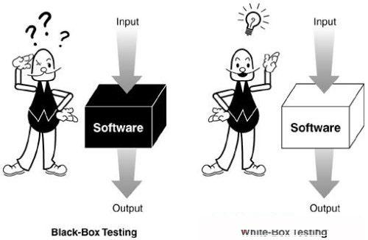
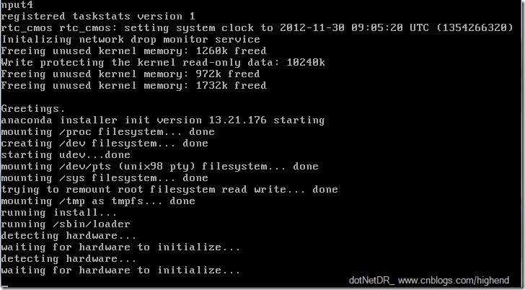
Design of Test Cases
Testing Techniques
Black Box Testing
White Box Testing
Static Testing
Dynamic Testing

Slide 213
Design of Test Cases
Black-box testing
Characteristics of Black-box testing:
Program is treated as a black box.
Implementation details do not matter.
Requires an end-user perspective.
Criteria are not precise.
Test planning can begin early.

Slide 214
Design of Test Cases
Dynamic black-box testing
Dynamic black-box testing is testing without having an insight into the details of the underlying code.
Dynamic, because the program is running
Black-box, because testing is done without knowledge of how the program is implemented.
Sometimes referred to as behavioral testing.
Requires an executable program and a specification (or at least a user manual).
Test cases are formulated as a set of pairs
E.g., (input, expected output)

Slide 215
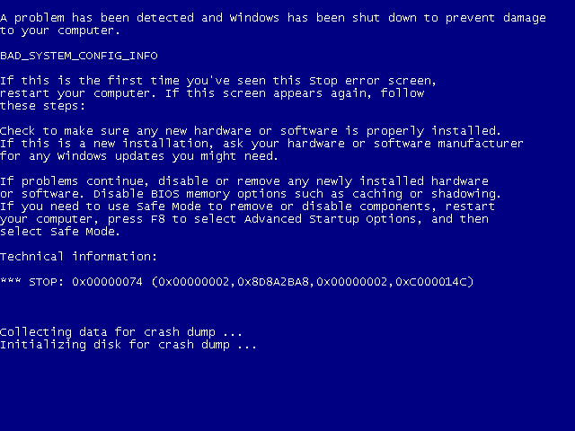
Design of Test Cases

Slide 216
Black-box Testing
Requirements
Output
B
Running SW
Given
Input A
Events

Slide 217
Black-box Testing
Test-to-pass and Test-to-fail
Test-to-pass:
assures that the software minimally works,
does not push the capabilities of the software,
applies simple and straightforward test cases,
does not try to “break” the program.
Test-to-fail:
designing and running test cases with the sole purpose of breaking the software.
strategically chosen test cases to probe for common weaknesses in the software.

Slide 218
Black-box Testing
Test Data and Test Cases
Test data: Inputs which have been devised to test the system.
Test cases: Inputs to test the system and the predicted outputs from these inputs if the system operates according to its specification.

Slide 219
Black-box Testing
Black-box testing

Slide 220
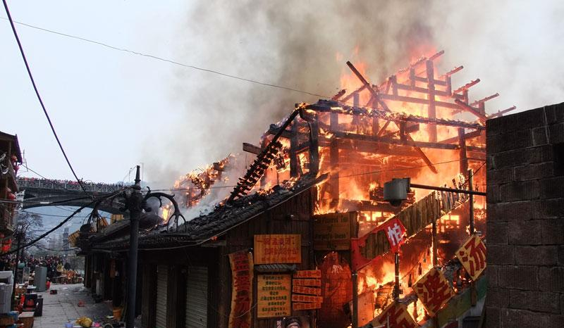

Black-box Testing
Test Case for a Bar
1 Beer
2 Beers
65536 Beers
-1 Beer
Adfsdagdsg Beer
锟斤拷烫烫烫 Beer
Where is the toilet?

Slide 221
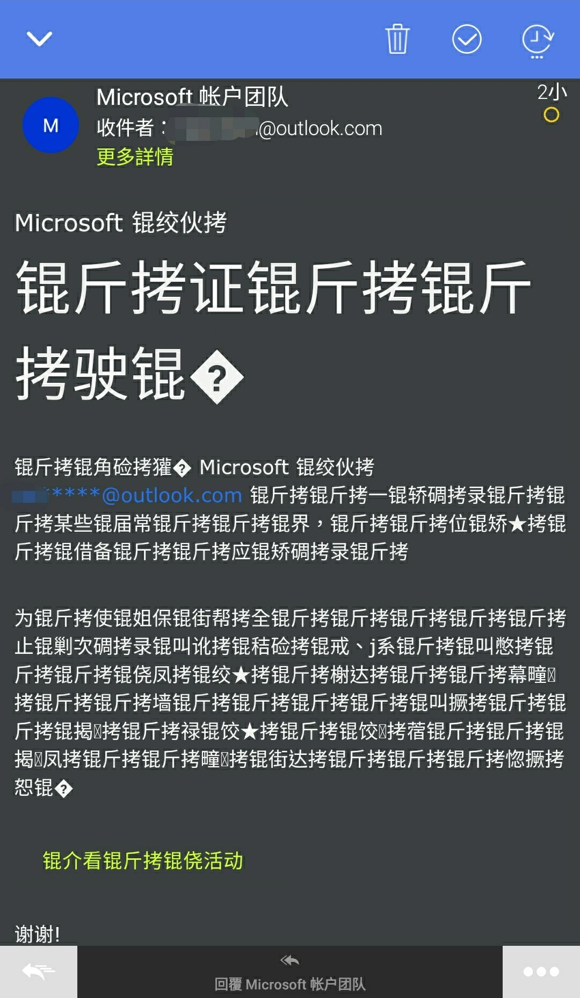
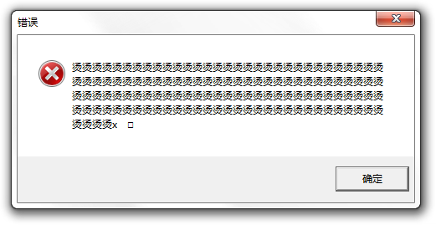
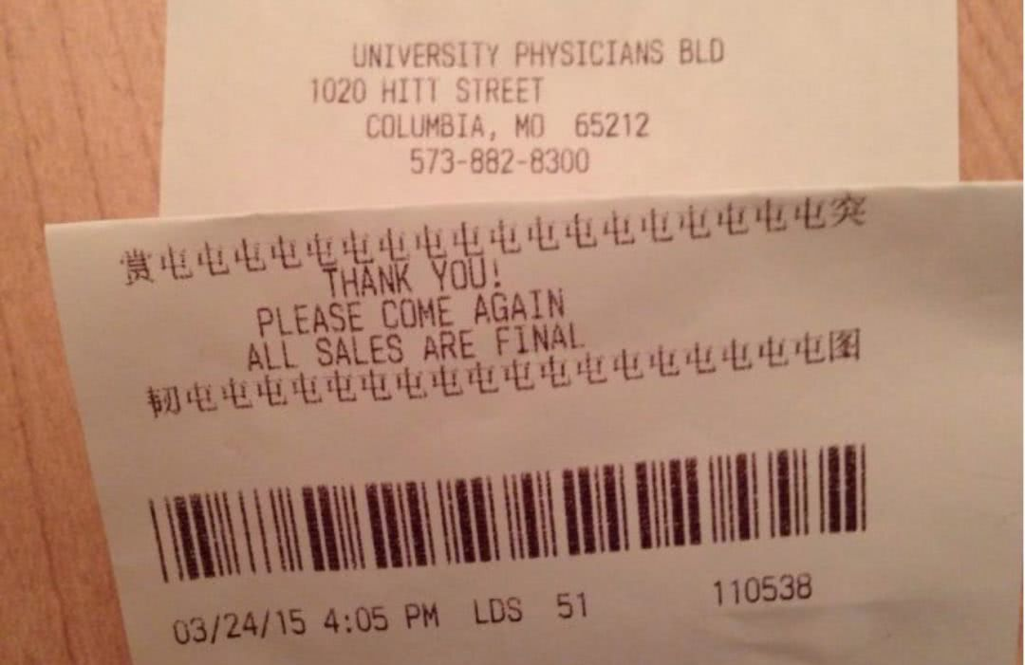
Black-box Testing

Slide 222
Black-box Testing
Obviously, we need something that defines the software--i.e. requirements document or specification document.
We must be able to specify what should be produced as output B, given input A.
We do NOT need to know HOW output B is produced from input A.
Although we can’t look at code, we may ask the programmers questions about numeric limits, internal quirks of the software etc.

Slide 223
Black-box Testing
Testing Methods in Black Box Testing
Random Testing
Equivalence Partitioning
Boundary Value Analysis
Cause Effect Analysis

Slide 224
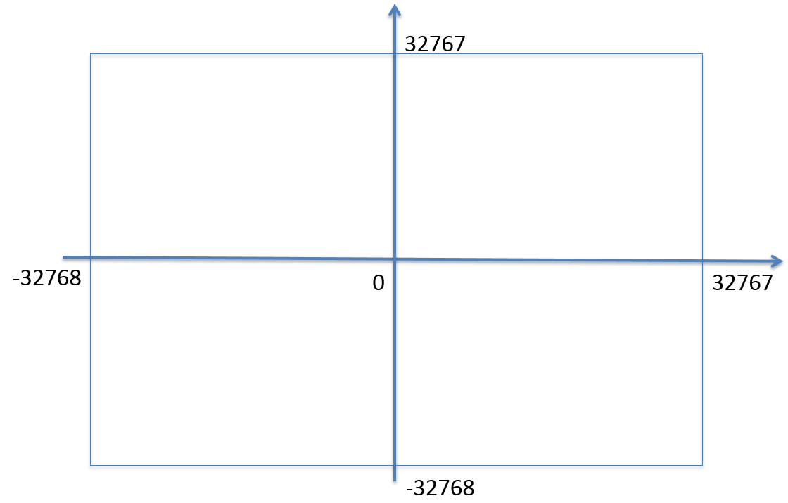
Random Testing
Test cases are generated purely at random [SWEBOK v3.0]
Input domain must be known
Pick random points within input domain
Automation
int Add(const int &a, const int &b)
{
return a+b;
}

Slide 225
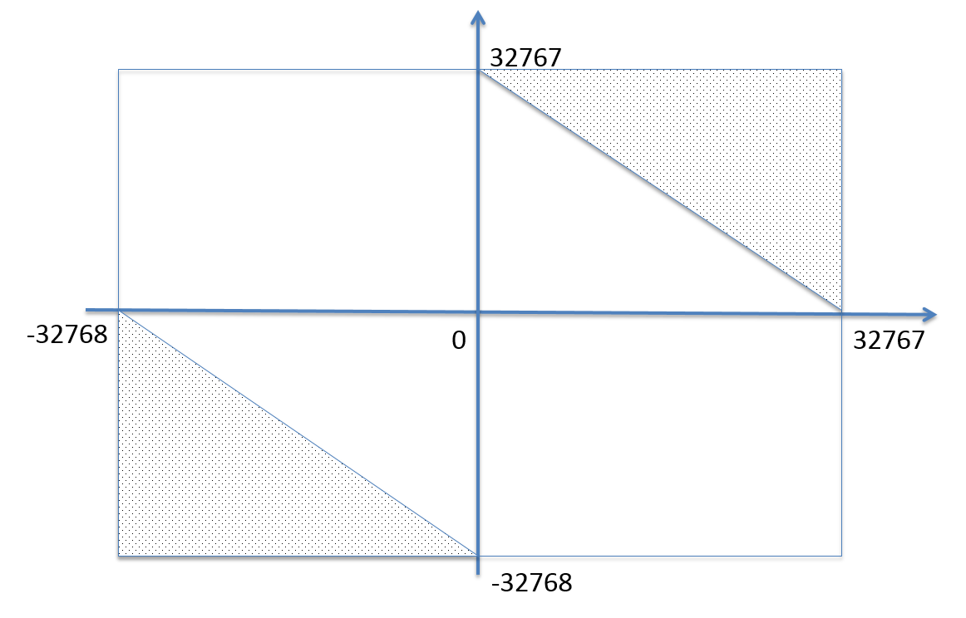
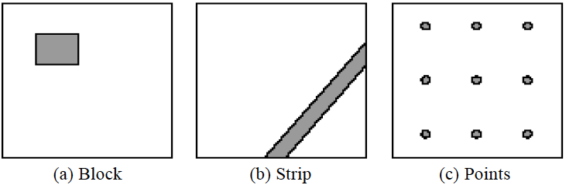
Adaptive Random Testing
int Add(const int &a, const int &b)
{
return a+b;
}
Typical patterns of failure-causing regions

Slide 226
Adaptive Random Testing
A passed test, nearby tests may be passed
A failed test, nearby tests may be failed
So, select test cases far away from others …

Slide 227
Black-box Testing
Testing Methods in Black Box Testing
Random Testing
Equivalence Partitioning
Boundary Value Analysis
Cause Effect Analysis

Slide 228
Define equivalence partitions - or classes
Equivalence partitioning helps us cut down the number of test cases without adding a great deal of risk.
Normally we look at two areas for testing:
- Data
- Logic flow
There are many guidelines for picking equivalence partitions.
Note: These are guidelines, not hard and fast rules.

Slide 229
Data Testing QUIDELINES FOR CHOOSING EQUIVALENCE CLASSES
Identify boundary conditions - data that is at the edge of the planned operational limits of the software.
For the boundaries, partition input into
- Valid data inside the boundary.
- Data just on the boundary (which may be valid or invalid).
- Invalid data just outside the boundary limits.
Boundary conditions should be identified in the requirements or the specifications.

Slide 230
Equivalence Partitioning 1
Idea is to partition the input space into a number of equivalence classes such that one could expect, based on the specification, that every element of a given class would be ‘‘handled’’ (i.e., mapped to
an output) in the same manner
(either correctly or incorrectly),
thus reducing the total number of test cases that must be developed.
Two types of classes are identified:
valid (corresponding to inputs deemed valid from the specification)
invalid (corresponding to inputs deemed erroneous from the specification)

Slide 231
Equivalence Partitioning 2
Divide all possible inputs into classes (partitions) such that : There is a finite number of input equivalence classes
You may reasonably assume that
The program behaves analogously for inputs in the same class
One test with a representative value from a class is sufficient
If the representative detects a fault, then other class members would detect the same fault
i₁
i₄
i₂
i₃
all inputs

Slide 232
Equivalence Classes
Valid data
User supplied commands.
Responses to system prompts.
File names.
Computational data:
Physical parameters,
Bounding values, and
Initiation values.
Output data formatting commands.
Responses to error messages.
Graphical data.
Invalid data
Data outside bounds of the program.
Physically impossible data.
Proper value supplied in wrong place.

Slide 233
Equivalence Classes Strategy
Identify input equivalence classes
Based on conditions on inputs/outputs in specification/description: Both valid and invalid input equivalence classes
Based on heuristics and experience :
“input x in [1..10]” → classes : x < 1, 1 ≤ x ≤ 10, x > 10
“enumeration A, B, C“ → classes : A, B, C, not{A,B,C,}
"input intege → classes : n not an integer, n < min, min ≤ n < 0, 0 ≤ n ≤ max, n > max
……
Define one/couple of test cases for each class
Test cases that cover valid classes
Test cases that cover at most one invalid class

Slide 234
Equivalence Partitioning Example 1
Partition system inputs into groups (partitions) that should cause
equivalent behaviour, include both valid and invalid inputs.
If input is a 5-digit integer between 10,000 and 99,999,
Equivalence partitions are:
< 10,000 10,000 - 99,999 > 99,999

Slide 235
Equivalence Partitioning Example 2
Identify (multiple sets of disjoint) equivalence classes for the following program specification fragment.
City Tax Specification:
1. If gross pay is no more than $30,000, the tax is 1%.
2. If gross pay is more than $30,000, but no more than $50,000, the tax is 5%.
3. If gross pay is more than $50,000, the tax is 15%.

Slide 236
Equivalence Partitioning 3
1. If input is a range, one valid and two invalid equivalence classes:
less than range
in range
greater than range
2. If input is a specific value, one valid and two invalid equivalence classes:
less than value
value
greater than value
3. If input is a set of related values, one valid and one invalid class:
not member of set
member of set
4. If input is Boolean, one valid and one invalid class:
nonBoolean
Boolean

Slide 237
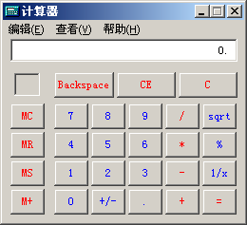
Equivalence Partitioning Example 3
Test for addition operation of MS calculator.
Class 1: Integer
Class 2: Decimal fraction
Class 3: Negative
Class 4: Invalid input

Slide 238
Further Partitioning Possibilities
Check default, empty, blank, null, zero, and no data.
- If nothing is entered, what happens?
- Default set?
- Error message?
- Hung program?
Check invalid, wrong, incorrect, and garbage data.
- Users WILL use the software incorrectly.
- Data loses or crashes are blamed on the software, always --- not the user
- Have fun with this one --- devious, tricky, and nasty are good traits for a tester!

Slide 239
Black-box Testing
Testing Methods in Black Box Testing
Random Testing
Equivalence Partitioning
Boundary Value Analysis
Cause Effect Analysis

Slide 240
Black-Box testing - Boundary Value Analysis (BVA)
A technique based on identifying, and generating test cases to explore boundary conditions.
Boundary conditions are an extremely rich source of errors.
Natural language based specifications of boundaries are often ambiguous, as in ‘‘for input values of X between 0 and 40,...’’
May be applied to both input and output conditions.
Also applicable to white box testing.
more errors occur at the boundaries of an input domain than in the “center”

Slide 241
Boundary Values
Based on experience / heuristics :
Testing boundary conditions of eq. classes is more effective i.e. values directly on, above, and beneath edges of classes
Choose input boundary values as tests in input classes instead of, or additional to arbitrary values
Choose also inputs that invoke output boundary values ( values on the boundary of output classes )
Example strategy as extension of equivalence partitioning:
choose one (n) arbitrary value(s) in each eq. class
choose values exactly on lower /upper boundaries of eq. class
choose values immediately below /above each boundary ( if applicable )

Slide 242
Guidelines for Identifying Boundary Values
1. If the input range is bounded by a and b, then use a, b, and values just above and just below a and b, respectively.
a
b
2. If the input is a number of values, use the minimum and maximum of the values and values just above and just below them, respectively.
a
b
3. Apply guidelines 1 and 2 to create output values at the minimum and maximum expected values.
4. If data structures have boundaries, test these boundary values and values just above and just below them, respectively.
e.g., for an array of bounds 1 to 10 — test array index equal to 0, 1,2, 9, 10, 11

Slide 243
BVA Example 1
Test a function for calculation of absolute value of an integer
Valid equivalence classes :
Condition Valid eq. classes Invalid eq. Classes
particular abs < 0, >= 0
Test cases :
class x < 0, arbitrary value: x = -10
class x >= 0, arbitrary value x = 100
classes x < 0, x >= 0, on boundary : x = 0
classes x < 0, x >= 0, below and above: x = -1, x = 1

Slide 244
BVA Example 2
Test a function which limit user input to 6-digit positive integer
Test cases :
Class arbitrary value: X1 = 123123
Class boundary value: X2 = 12345
Class boundary value: X3 = 1234567
Class boundary value: X4 = 1
Class boundary value: X5 = 0
Class invalid value: X6 = -123123
Class invalid value: X7 = asdasd
Others?
Class invalid value: X8 = 000123
X9 = asd123;
X10 = Empty

Slide 245
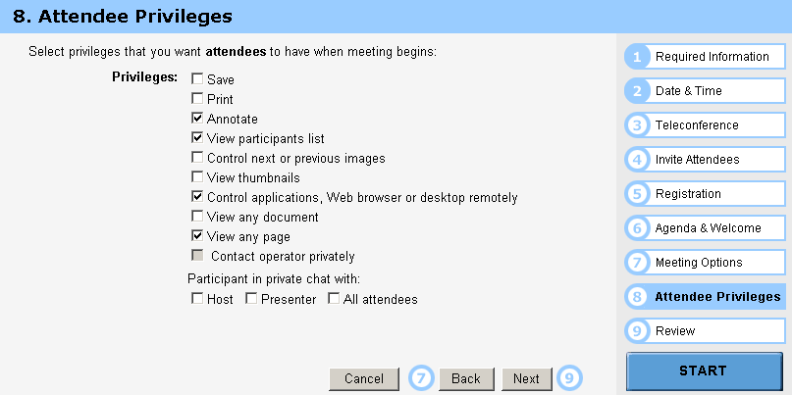
BVA Example 3
Test cases :
Class arbitrary value: Random select some options Class boundary value: Select all options Class boundary value: Select none option Class boundary value: Select 1 option

Slide 246
Other types in Boundary
First/last
Min/Max
Star/Finish
Empty/Full
Slower/Faster
Largest/Smallest
Over/Under
Shortest/Longest
… …
Numeric
Character
Position
Quantity
Speed
Location
Size

Slide 247
Examples of possible boundary conditions
Limits on input data – size, type
Limits on output data- size, type
Look for limits such as
First-1/Last+1
Start-1/Finish+1
Min-1/max+1
Less than empty/ more than full
just Over/Just Under
etc.
Don’t hesitate to choose data outside boundaries, even when it seems absurd.

Slide 248
Examples
The schedule manager schedules a meeting to (a) time slot(s) as part of the 5-day schedule for the event. To accomplish this, the user must input three items:
1. The day (1, 2, 3, 4, or 5), chosen from a drop-down list.
2. The time slot(s), chosen through some type of user interface. Each day of the event lasts from 10am-6pm. There are 8, 1-hour time slots available per day (10-11am, 11am-12pm, 12-1pm, 1-2pm, 2-3pm, 3-4pm, 4-5pm, 5-6pm). A meeting can be scheduled for a 1-hour, 2-hour, or 3-hour time slot.
3. The name of the meeting (chosen from a drop-down list of meetings that the system already knows about)
The output would be a meeting being scheduled for a particular date and time (as reflected in the schedule). For example, if one of my test cases consisted of: {Day 3, 11am-1pm, The Go-Go's}, the expected output for this test case would be the Go-Go's being scheduled for Day3 of the festival in the 11am-1pm time slot.
(The minimum time unit is 1 hour. Minutes are not considered in this question)

Slide 249
Examples
If you take the train before 9:30 AM or in the afternoon after 4:00 PM until 7:30 PM (‘rush hour’) you must pay full fare. A saver ticket is available for trains between 9:30 AM and 4:00 PM, and after 9:30 PM.
Q1: What are the partitions and boundary values to test the train times for this ticket types?
Q2: Which are valid partitions and which are invalid partitions?
Q3: What are the boundary values? (A table may be useful)
Q4: Design test cases for the partitions and boundaries.
Q5: Do you have any questions about this ‘requirement’? Is anything unclear?

Slide 250
Guidelines for choosing Equivalence classes For Data Testing
Identify sub-boundary conditions or internal boundary conditions
Some limits may not be apparent to the general end user.
To locate some of these, you may need to talk with programmers.
Example: Powers-of-two boundary conditions

Slide 251
Power-of-Two
Binary: 0 and 1, byte is made up of 8 bits, word is made up of 4 bytes, …
Term | Range or Value
Bit Nibble Byte Word Kilo Mega Giga Tera | 0 or 1 0-15 <Half byte> 0-255 0-65535 or 0-4294967295 1024 1048576 1073741824 1099511627776

Slide 252
EXAMPLE: Powers-of-Two
Often a programmer will handle data differently depending upon its size.
Example: Communications software where with limited bandwidth, we try to keep the size of data being transmitted low.
Program transmits 256 commands, but uses only a nibble (4 bits) to encode the 15 most commonly used commands.
Thus, there is an internal boundary between the 4th and 5th bit
Might try transmitting 3, 4, 5 bits in addition to ones determined by the stated boundary conditions of 1 and 8 bits.

Slide 253
An Example: A flight simulator
Assume the user can control the height of the plane, determine what those limits are:
Not specified?
Why not?
Nothing in a computer is infinite!
Try flying
Below ground
In outer space
Through a mountain (or some other object)

Slide 254
ASCII Table
Character | ASCII Value | Character | ASCII Value
Null Space / 0 1 2 9 ; @ A | 0 32 47 48 49 50 57 58 64 65 | B Y Z [ ‘ a b y z { | 66 89 90 91 96 97 98 121 122 123

Slide 255
ASCII Encoding Always Produce Sub-Boundary Conditions
The ASCII code is 8 bits.
If numeric digits are to be input,
check just out of range with the ‘/’ and ‘:’
If capital letters are to be input,
check just out of range with the ‘@’ and ‘[‘
If lower case letters are to be input,
check just out of range with the forward quote and the ‘{‘.
Character | ASCII Value | Character | ASCII Value
Null Space / 0 1 2 9 ; @ A | 0 32 47 48 49 50 57 58 64 65 | B Y Z [ ‘ a b y z { | 66 89 90 91 96 97 98 121 122 123
NOTE: The error in using the default settings in the PowerPoint software. In each case, I encased the character in a single quote--- i.e. the key below “.

Slide 256

Text-box Field
Default
Empty
Blank
Null
Zero
None

Slide 257
Black-box Testing
Testing Methods in Black Box Testing
Random Testing
Equivalence Partitioning
Boundary Value Analysis
Cause Effect Analysis

Slide 258
Cause-Effect Analysis
Cause-Effect Analysis is a systematic means for generating test cases to cover different combinations of input ‘‘Causes’’ resulting in output ‘‘Effects.’’
A CAUSE may be thought of as a distinct input condition, or an ‘‘equivalence class’’ of input conditions.
An EFFECT may be thought of as a distinct output condition, or a meaningful change in program state.
Causes and Effects are represented as Boolean variables and the logical relationships among them CAN (but need not) be represented as one or more boolean graphs.

Slide 259
Cause-Effect Analysis Sample 1
Given inputs maxint and N compute result :
|N|
∑
result = if this <= maxint, error otherwise
k
K=0
Valid equivalence classes : condition valid eq. classes . abs(N) N < 0, N ≥ 0 maxint ∑ k ≤ maxint, ∑ k > maxint
Test Cases :
maxint N result maxint N result
55 10 55 100 0 0 54 10 error 100 -1 1 56 10 55 100 1 1 0 0 0 … … …

Slide 260
Cause-Effect Analysis
How to combine the boundary conditions of different inputs ?
Take all possible boundary combinations ?
This may blow up ……

Slide 261
Cause-Effect Analysis 2
Systematic method for generating test cases representing combinations of conditions
Combinatorial explosion of number of possible combinations
Some heuristics to reduce this combinatorial explosion
Starting point is effects (outputs) then working ‘backwards’
‘light-weight’ formal methods: transformation into semi-formal Boolean graph
A technique : to be combined with others

Slide 262
Cause-Effect Analysis Sample 3
∑ k ≤ maxint
∑ k > maxint
N < 0
N ≥ 0
and
∑ k
error
and
xor
Causes ∑ k ≤ maxint 1 1 0 0
Inputs ∑ k > maxint 0 0 1 1
N < 0 1 0 1 0
N ≥ 0 0 1 0 1
Effects ∑ k 1 1 0 0
Outputs error 0 0 1 1

Slide 263
Cause-Effect Analysis 3
Black-box technique to analyze combinations of input conditions
Identify causes and effects in specification ↓ ↓ inputs outputs current state new state
Make Boolean Graph linking causes and effects
Annotate impossible combinations of causes and effects
Develop decision table from graph with in each column a particular combination of inputs and outputs
Transform each column into test case

Slide 264
C-E Analysis Process Steps
Cause-effect graphing consists of the following 4 steps
List and label causes (input-events) and effects (output actions) for a module
Draw a cause-effect graph describing the logical combinations of causes, intermediate causes and resulting effects,
Develop a decision table (causes vs effects) from the graph
Convert each row into a test case, or a set of rows into a testing scenario

Slide 265
Cause-Effect Analysis Sample 4
Case Matrix:
Cause
∑ k ≤ maxint
1
1
0
0
∑ k > maxint
0
0
1
1
N < 0
1
0
1
0
N ≥ 0
0
1
0
1
Effects
∑ k
1
1
0
0
error
0
0
1
1

Slide 266
Two Approaches
Running
Running
Test Driver
Tested Module
=main()
call
Tested Module
Test Stub
a special-purpose program to simulate the activity of the missing component
Driver: component that calls component to be tested
Stub: component called by component to be tested

Slide 267
Unit test procedure
Driver
interface
local data structures
boundary conditions
independent paths
error-handling paths
Component
to be tested
Results
Test cases
Stub
Stub
driver and/or stubs must be developed for each unit test

Slide 268
Unit test procedure
public class unittest{
//Test driver
public static void main(String[] args) {
unittest d = new unittest();
d.Add();
}
//My module
public int Add() {
int output=this.Stub1() + this.Stub2();
System.out.print("My module: return value is "+output+"\n");
return output;
}
//Stub1 public int Stub1() {
int output=3;
System.out.print("Stub 1 : return value is "+output+"\n");
return output; }
//Stub2 public int Stub2() {
int output=7;
System.out.print("Stub 2 : return value is "+output+"\n");
return output; }
}

Slide 269
Integration Testing
If components all work individually, why more testing?
Interaction errors cannot be uncovered by unit testing!
(e.g., interface misuse, interface misunderstanding, timing errors)
Integration approaches
Big Bang!!
Incremental
construction
strategy
Versus
Incremental
“builds”
Regression
testing

Slide 270
Unit Tests vs Integration Tests
Unit tests – Test the pieces of code- the modules (functions, subroutines, etc.)
Integration tests – Test the program or combinations of modules.
Both of these need to be done, but two different strategies are used typically:
Bottom-up Testing
Top-down testing
Note: Mixed strategies can be used, but it is best to consider these separately.

Slide 271
Bottom-up Testing vs Top-down Testing
Bottom-up testing
Test the units as they are completed.
Debug the units.
Integrate some of the units and test the integration.
Debug the integrated units.
Continue until ....???
Note: to test the integrated units, driver code (which later may be thrown away) must be written.

Slide 272
Bottom-up Integration
A
B
C
D
E
F
G
Test E
Test B,E,F
Test A,B,C,D,E,F,G
Test F
Test C
Test G
Test D,G

Slide 273
Pros & cons
Advantage:
- Popular approach
- Is useful when many of low-level components are general-purpose utility routines that are invoked often by others
- Integrated test by component driver
- Test data and test case are created easily
Disadvantage:
- Top-level components are usually the most important but the last to be tested
- Sometimes faults in the top levels reflect faults in design, obviously, these problems should be corrected ASAP
- It is difficult to test a system from bottom up when much of the system’s processing depends on timing

Slide 274
Bottom-up Testing vs Top-down Testing
Top-down Testing
Write a top function first, such as the main function.
Write stubs to handle calls to other functions.
A stub is code that sets variables that must be returned to the calling function and may only just print something such as “In Module A”.
Test and debug the top function.
Replace the stub with actual code.
Test and debug the stub with its calling function(s).
Repeat until ... ???

Slide 275
Top-down integration
A
B
C
D
E
F
G
Test A
Test A,B,C,D,E,F,G
Test A,B,C,D

Slide 276
Pros & cons
Advantage:
- The most important components can be tested early
- Apply to top-down design and code
- Driver programs are not needed in top-down testing
- Logic and structure is clear
Disadvantage:
- A very large number of stubs (a special-purpose program to simulate the activity of the missing component) may be required
- Testing each level’s component individually introduces another difficulty

Slide 277
Modified Top-down integration
A
B
C
D
E
F
G
Test B
Test E
Test A
Test C
Test A,B.C,D
Test F
Test A,B,C,D,E,F,G
Test D
Test G

Slide 278

System Testing
Functional Behavior and Codes
Spec: The bird can fly…

Slide 279
16 Weeks Plan
Week 1: The basic concepts and theories of testing
Week 2-3: Principles of Testing
Week 4-5: White Box Testing
Week 6-7: Test Cases & Black Box Testing
Week 8: Usability Testing
Week 9: Mutation Testing & Finite Automata
Week 10: Mid-term Review and System Testing
Week 11: Empirical Software Testing
Week 12: Interaction System Testing
Week 13-14: ML & AI System Testing
Week 15-16: Conclusion & General Review

Slide 280
System Testing
Topics in Testing Software
Usability

Slide 281
System Testing
Software Usability
Eventually a person will interact with a software system.
Software usability is how:
appropriate
functional
effective
that interaction is.
Ergonomics is the science of designing everyday things so that they are easy and functional to use.

Slide 282

System Testing
Important traits of a good UI
Follows standards and guidelines
Intuitive
Consistent
Flexible
Comfortable
Correct
Useful

Slide 283





System Testing
Important traits of a good UI
iOS1-2007
iOS2-2008
iOS3-2009
iOS4-2010
iOS5-2011

Slide 284






System Testing
Important traits of a good UI
iOS6-2012
iOS7-2013
iOS8-2014
iOS9-2015
iOS10-2016

Slide 285






System Testing
Important traits of a good UI
iOS11-2017
iOS12-2018
iOS13-2019
iOS14-2020
iOS20?

Slide 286
System Testing
Follows UI standards and guidelines
Macintosh Human Interface Guidelines
http://developer.apple.com/documentation/UserExperience/Conceptual/OSXHIGuidelines/XHIGIntro/chapter_1_section_1.html
Microsoft Windows User Experience
http://msdn2.microsoft.com/en-us/library/aa511258.aspx
These guides detail how software that runs on each platform should look and feel to the user.
When should a check box be used instead of a button?
When is it proper to use information, warning, or critical messages?

Slide 287
System Testing
Follows UI standards and guidelines (cont’d)
The standards guidelines for a platform should be treated as an addendum to the product specification.
Test cases should be created based on the standards guidelines in addition to the test case created from the product’s specification.
If the development platform does not have a standard, the design team must create usability standards for the software itself.

Slide 288
System Testing
Intuitive UI
Is the UI clean, unobtrusive, not busy?
Are responses obvious and there when you expect them?
Is the UI organized and laid out well?
Are the inputs acknowledged?
Do the menus go too deep?
Is there excessive functionality?
Is there information overload?
Does the help system really help the user?

Slide 289


System Testing
Non-intuitive UIs

Slide 290


System Testing
Non-intuitive UIs

Slide 291



System Testing
Intuitive Ui (?)

Slide 292

System Testing
Intuitive UI (?)

Slide 293

System Testing
Intuitive UI

Slide 294


System Testing
Intuitive UI (?)

Slide 295
System Testing
Consistent UI
Shortcut keys and menu selections
F1 should always get you Help in MS Windows.
Different UI paths should have the same F key to execute a feature.
Terminology and naming
Is Find sometimes called Search?
Audience
Consider the success of the UI of the car and ATM.
Placement of buttons such as OK and Cancel
In Mac OS, the OK button is always on the right.
In MS Windows the, the OK button is on the left and Cancel is on the right.

Slide 296




System Testing
Consistent UI

Slide 297



System Testing
Consistent UI

Slide 298

System Testing
Consistent UI

Slide 299

System Testing
Consistent UI

Slide 300

System Testing
Consistent UI

Slide 301

System Testing
Consistent UI

Slide 302


System Testing
Consistent UI

Slide 303

System Testing
Consistent UI

Slide 304

System Testing
Consistent UI

Slide 305

System Testing
Consistent UI

Slide 306


System Testing
Flexible UI
Users like choices … but not too many.
E.g., MS simple and scientific calculators
Flexible UIs provide:
State jumping
Many alternative ways to achieve the same goal.
State termination and skipping
“If you know your party’s extension enter it at any time”.
Multiple ways to perform I/O
Excel allows many input formats (from keyboard or files) and many output formats (table, graphs, charts).

Slide 307
System Testing
Comfortable UI
Sounds like a strange notion …
Is the UI appropriate?
Sound effects in a computer game? How about a business application?
Does the UI handle errors well?
If there is no Undo/Redo feature critical operations may fail.
Is the feedback fast enough or too fast?
E.g., waiting for cash to come out of the ATM
Does excessive use cause harm?
E.g., Emacs hand

Slide 308
System Testing
Correct UI
Marketing differences
Are there extra or missing functions from what the marketing material states?
Language and spelling
Error messages often have spelling mistakes
Bad media (icons, images, sounds, videos) that for with the software UI.
WYSIWYG
E.g., does the printed Adobe Acrobat file look like the one on the screen?

Slide 309
System Testing
Useful UI
When testing a UI feature, ask if the feature you see actually contributes to the software’s value.
Many applets have useless features
E.g., dancing elves
Useless UI features waste time for the user, developer, and tester.

Slide 310

Useful UI

Slide 311




Useful UI

Slide 312

Useful UI

Slide 313


Useful UI

Slide 314
System Testing
Accessibility Testing (testing for the disabled)
Nearly 20% of American have some form of disability according to the 1997 US Census.
The following impairments make using computers especially difficult:
Visual
E.g., color blindness, tunnel vision, cataracts.
Hearing
E.g., partial or complete deafness.
Motion
E.g., injury can make using a keyboard or mouse difficult or impossible.
Cognitive and language
E.g., dyslexia or memory problems and using complex UIs

Slide 315
System Testing
Legal requirements
In the US, three laws apply to developing software with a UI that can be used by the disabled:
The Americans with Disability Act (ADA) has been applied to commercial Internet websites.
Section 508 of the Rehabilitation Act is similar to the ADA and applies to any organization that receives federal funding.
Section 255 of the Telecommunications Act requires all hardware and software that transfers information over the Internet/network/phone line be accessible to people with disabilities.

Slide 316
System Testing
Accessibility features in software
If the software being tested does not run on a platform that has specified accessibility features?
Accessibility features will have to be specified, programmed, and tested.
If your platform has built in accessibility features your software?
Software only needs to adhere to the platform’s standard for communicating with peripheral devices.
Remember to create test cases specifically to test for accessibility.
Add them to your configuration testing equivalence partitions.

Slide 317
System Testing
Microsoft Windows accessibility features
Sticky-keys: Allow Shift, Ctrl, Alt keys to stay in effect until the next key is pressed.
Filter-keys: prevents brief repeated keystrokes from being recognized.
Toggle-keys: plays tomes when Caps Lock, Scroll Lock, or Num Lock keyboard modes are enabled.
Sound-sentry: creates a visual warning whenever the system generates a sound.
Show-sounds: instructs program to display captions for any sounds or speech they make.

Slide 318
System Testing
Microsoft Windows accessibility features (cont’d)
High contrast: sets up the screen with colors and fonts designed to be read by the visually impaired.
Mouse-keys: allows the use of keyboard keys instead of he mouse to navigate.
Serial-keys: sets up a communication port to read in key strokes from an external (non-keyboard) device.

Slide 319


System Testing
Microsoft’s accessibility website

Slide 320


System Testing
Apple’s accessibility website

Slide 321
System Testing
System Testing
Example: Website Testing

Slide 322
System Testing
How to test a website
Easiest way to start is by treating the web site as a black box.
Look at a sample website such as www.apple.com to get a sense of the scale of such an endeavor.
Treat each page as a state with hyperlinks as state transitions.

Slide 323
System Testing
Website text
Web page text should be treated like documentation and tested using the techniques we described previously.
Check for …
correctness of contact information e.g., phone numbers, addresses
correctness of dates and copyright notices
title bar text, bookmark text on browser’s favorites
correctness of the ALT text (i.e., mouse over text)
layout issues when browser window is resized

Slide 324
System Testing
Website hyperlinks
Each link should be checked to make sure it jumps to the correct destination or website.
Ensure that hyperlinks are obvious:
E.g., underlined text, mouse pointer changes
If the link opens an e-mail message, test it
Send an e-mail and verify that you get a response.
Check for orphan pages that are part of the website but cannot be accesses through a hyperlink.
Someone forgot to create the link
Might be intentional … Google will find it, though

Slide 325
System Testing
Website graphics
Do all graphics load and display properly?
Is a graphic missing or incorrectly named?
Does the website intermix text and graphics?
Does the text wrap around the graphics?
What happens when the browser window is re-sized?
Does the page load fast enough?
Are there too many graphics?
Did you try to test the website on a dialup connection instead of a high-speed LAN?

Slide 326

System Testing
Website forms
Forms are the text boxes, list boxes, and other fields for entering and selecting information on the web page.
Are the form fields positioned properly?
Are the fields the correct size?
Do they accept correct data?
Do they reject bad data?
Are optional fields really optional?
A favorite entry point for buffer overflow attacks (more on this later).

Slide 327
System Testing
“Grey-box” testing
A mixture of white-box and black-box testing.
You stick to black-box testing primarily and supplement it by taking a peek at the HTML to figure out how the website works.
For website testing it is worth looking at the HTML code.
It’s there, easy to look at, why not?
Not looking at the HTML code is wasteful, especially since HTML is such a simple language.
HTML is a tagging language for text and graphics.
To create dynamic web content requires that HTML be supplemented by programming code (e.g., Java applets, ActiveX, VBScript, CGI, Perl).

Slide 328
System Testing
White-box testing
To make sure you find the important bugs you should have some knowledge of the website’s programming:
Dynamic content
Database-driven web pages
Programmatically created web pages
Server performance and loading and security

Slide 329
Dynamic content
Dynamic content is graphics and text that changes based on certain conditions.
E.g., time of day, weather, stock tickers
Client-side programming involve embedding scripting code (e.g., JavaScript) into HTML.
Less efficient if the computations are expensive
Code is local, easy to access for testing
Server-side programming is code located on the server.
More efficient for intensive calculations
Requires access to the web server to view the code (might be a problem for testing).

Slide 330
Database-driven web pages
Most E-commerce that show catalogs or inventories are database driven.
E.g., Amazon
Data is pulled from the database, formatted into HTML and sent to the web browser for viewing A three tier architecture is used:
Tier 1: web browsers (presentation)
Tier 2: web page formatter (converts data from Tier 3 to HTML)
Tier 3: database (queried by Tier 2)

Slide 331
Programmatically- Created web pages
HTML or code is generated by a program.
E.g., a web designer may drag and drop elements in a layout program, press a button, and get an HTML page.
Compilers do this all the time, except they translate high-level language code (Java source code) into low-level code that can be executed natively or on a VM (e.g., byte code).
Testing these systems is like testing a compiler …
Automation? (Selenium) (Video)

Slide 332
System Testing
Server performance loading and security
Popular websites can receive millions of hits per day.
www.youtube.com hits 100 Million Videos per day
Each hit requires a download of data from the website’s server to the browser’s computer.
You need to simulate millions of connections and downloads to test a system for performance and loading.
Security issues include:
Denial of service attacks
Buffer overflow attacks

Slide 333
Configuration and compatibility testing
Hardware platform
Mac, PC, PDA, WiFi wristwatch?
Browser software version
Firefox 1.0, IE 6.0, Pocket IE, Netscape 7.2, Safari 2.0.4
Browser plug-ins
To play specific types of audio or video files
Browser options
Security options, ALT text, plug-in, pop ups
Video resolution and color depth
640x480, 800x600, 1024x768, 1280x1024, 256 colors, 16 colors
Text size
Small fonts, medium fonts, large fonts
Connection speed
DSL, modems of varying speed.

Slide 334
System Testing
Usability testing: Jacob Nielsen’s top 10 mistakes in web design
Gratuitous use of bleeding-edge technology
Scrolling text, marquees, and constantly running animations
Long scrolling pages
Non-standard link colors
Outdated information (need website maintenance)
Overly long download times (more than 10 sec to load)
Lack of navigation support
Orphan pages
Complex website addresses (URLs)
Using Frames (just open another window …)

Slide 335
System Testing
Website testing tools
Check out www.netmechanic.com
Website testing is very labor-intensive.
Tools that automatically check websites for:
Browser compatibility
Performance problems
Broken hyperlinks
HTML standard adherence
Spelling on text

Slide 336
System Testing
Web applications
Website - requests are navigational requests.
Web Application - requests can affect the state of the business logic on the server.
Client
Browser
A
Web Server
B
Scripts and Application
Server
C
Database
Server
F
E
D
A: Request
B: Request for page generation
C: SQL command
D: Result set
E: Dynamically generated page
F: Response (dynamic | static page)

Slide 337
System Testing
Web application failures
A 2003 study by the Business Internet Group of San Francisco found that:
72% (29/40) leading e-commerce sites, and
68% (28/41) government sites contained Web application failures
25 “technical errors”
E.g., page not found, multiple attempts to subscribe to a service
3 data errors
E.g., page without text, wrong page returned

Slide 338
System Testing
What type of bugs? Study by Kallepalli and Tian [IEEE TSE].
Analyzed the logs of the Web pages of Southern Methodist University for usage and failure information.
Looked at data from 26 consecutive days.
Total number of “hits” 762,971 (~30,000 hits/day)
A “hit” is registered for each Web page if one of the following happens:
The HTML file corresponding to a page is requested.
Any graphics within the HTML page is requested.

Slide 339
Bug types
Permission denied
No such file or directory
Stale NFS handle
Client denied by server configuration
File does not exist
Invalid method in request
Invalid URL in request connection
Mod_mime_magic
Request failed
Script not found or unable to start
Connection reset by peer
2079
14
4
2
28631
0
1
1
1
27
0

Slide 340
System Testing
About the bugs
“Permission denied”
Unauthorized access to restricted resources
Is this a bug?
“File does not exist”
Wrongfully denied access to restricted or unrestricted resources e.g., wrong file access code

Slide 341
Load Testing Tools (From Abraham Jacob)
Microsoft's web application stress tool | 0
Cyrona's OpenSTA | 1
Quest Software's benchmark factory | 4
Empirix's E-Test Suite 6.0 | 6
RadView's WebLoad 5.0 | 7
IBM Rational Robot | 7
HP Mercury LoadRunner | 8
Compuware's QA Load 4.7 | 10
Segue Software's SilkPerformer 5.0 | 10+
Best

Slide 342




Test Tools

Slide 343
To be continued… See you next week

Slide 344
Software Quality Assurance and Testing Technology
1st Semester, Fall 2022
Xiaoping CHE (xpche@bjtu.edu.cn)
Associate Professor
School of Software Engineering
Beijing Jiaotong University

Slide 345
1 int main() {
2 int i;
3 double number, sum = 0.0;
4 for (i = 1; i <= 10; ++i) {
5 printf("Enter a n%d: ", i);
6 scanf("%lf", &number);
7 if (number < 0.0) {
8 continue;
9 }
10 sum += number;
11 }
12 printf("Sum = %.2lf", sum);
13 return 0;
14 }

Slide 346
1. function radixSort(arr, maxDigit) {
2. varmod = 10;
3. vardev = 1;
4. for(vari = 0; i < maxDigit; i++, dev *= 10, mod *= 10) {
5. for(varj = 0; j < arr.length; j++) {
6. varbucket = parseInt((arr[j] % mod) / dev);
7. if(counter[bucket]==null) {
8. counter[bucket] = [];
9. }
10. counter[bucket].push(arr[j]);
11. }
12. varpos = 0;
13. for(varj = 0; j < counter.length; j++) {
14. varvalue =null;
15. if(counter[j]!=null) {
16. while((value = counter[j].shift()) !=null) {
17. arr[pos++] = value;
18. }
19. }
20. }
21. }
22. return arr;
23. }

Slide 347
public class TestBreakContinue {
public static void main(String[] args) {
int total = 0;
System.out.println("Begin");
while (true) {
total++;
int i = (int) Math.round(100 * Math.random());
if (i == 88) {
break;
}
}
for (int i = 100; i < 150; i++) {
if (i % 3 == 0) {
continue;
}
System.out.println(i);
}
int count = 0;
outer: for (int i = 101; i < 150; i++) {
for (int j = 2; j < i / 2; j++) {
if (i % j == 0)
continue outer;
}
System.out.print(i + " ");
}
}
}

Slide 348
If you take the train before 9:30 AM or in the afternoon after 4:00 PM until 7:30 PM (‘rush hour’) you must pay full fare. A saver ticket is available for trains between 9:30 AM and 4:00 PM, and after 9:30 PM.
Q1: What are the partitions and boundary values to test the train times for this ticket types?
Q2: Which are valid partitions and which are invalid partitions?
Q3: What are the boundary values? (A table may be useful)
Q4: Design test cases for the partitions and boundaries.
Q5: Do you have any questions about this ‘requirement’? Is anything unclear?

Slide 349
Q1: Please put the test cases that implement the following test conditions into the best order for the test execution schedule and explain why, for a test that is checking modifications of customers on a database.
1) Print modified customer record
2) Change customer address: House number and street name
3) Capture and print the on-screen error message
4) Change customer address: Postal code
5) Confirm existing customer is on the database by opening that record
6) Close the customer record and close the database
7) Try to add a new customer with no details at all
Answer: 5, 4(2), 2(4), 1, 7, 3, 6

